Slide 1
The PICOT Elements
P (Patient or Population)
C (Comparison)
O (Outcome)
I (Intervention)
T (Time)
Independent
Variable
Dependent
Variable

Slide 2
Sample Worksheet
Clinical Question
Population and/or Patient(s) | Intervention/Interest Area | Comparison Intervention (Often current practice) | Outcome | Time Period (If Applicable; Optional)
P: | I: | C: | O: | T:
Final Clinical Question:

Slide 3
Sample Worksheet
Searchable Question
Key Search Terms:
Inclusion Criteria:
Exclusion Criteria:
Limiters (Open year or year ranges, age ranges, and language, etc):
Databases:
Professional Organizations:

Slide 4
Examples of EBP Models
Johns Hopkins Nursing EBP Model
(Dearholt & Deng, 2012)
ARCC-E Model
(Melnyk & Fineout-Overholt, 2019)
ACE Star of Model
Transformation
(Stevens, 2012)
Stetler’s Model
(Stetler, 2010)
Diffusion of Innovations
Model
(Rogers, 1995)
PARISHS Model
(Harvey & Kitson, 2016, Rycroft Malone et al., 2013)
Iowa Model
(Buckwalter et al., 2017; Titler et al., 2001)
(Polit & Beck, 2021 )

Slide 5
Systematic Approach: Seven Steps of Evidence-Based Practice
Step 0:
Cultivate a spirit of inquiry
Step 1:
Identify the problem/Ask the PICO(T) question
Step 3:
Step 2:
Step 4:
Step 5:
Step 6:
Search/Acquire for the Best Evidence
Critically Appraise the Evidence
Integrate the evidence with clinical practice + patient preferences = make the best clinical decision
Evaluate the outcome(s) of the EBP practice change
Disseminate EBP outcome(s)
(Melnyk et al., 2014)

Slide 6
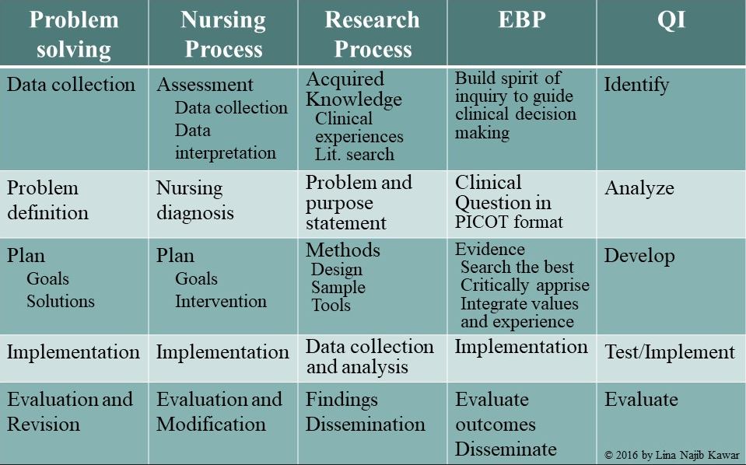
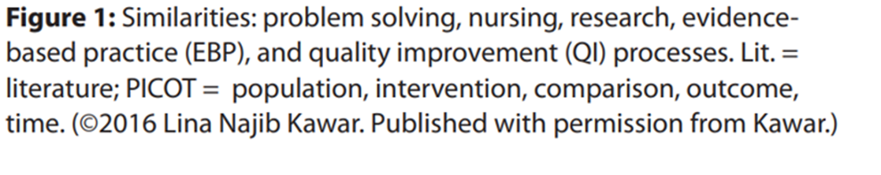
Similarities and Differences between Nursing Research, EBP, QI

Slide 7
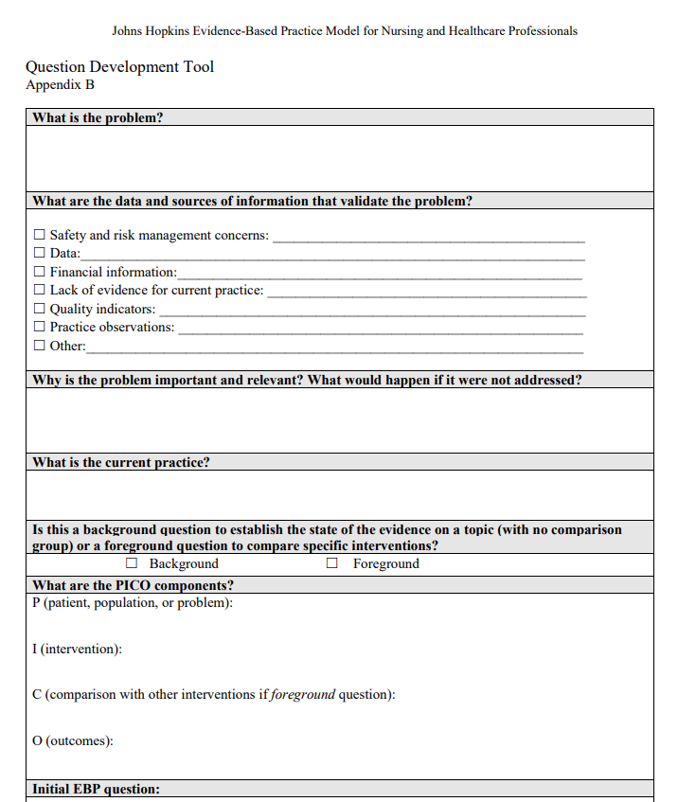
Example of Implementation of an Evidence Review using Johns Hopkins
EBP Model
Case Scenario- Phase 1 Identify the problem
You are a registered nurse working in the medical surgical unit. One of your patients is getting ready for an elective surgery to the right total hip. There is an order for applying chlorhexidine gluconate (CHG) wipes before surgery, but the patient is curious to understand the need for the wipes when they have already had a bath. As the nurse you explain the rationale for using the CHG wipes for the prevention of surgical site infections, but you start to notice that there is inconsistencies with this intervention and if there are standardized best practices on the use of CHG showers or bathing.
At the next local nursing research and EBP meeting, you discuss this case. The committee decides to look at the literature to determine if there is evidence for successful implementation and protocols of CHG.

Slide 8
Based on this scenario, Phase 1 Development of the PICOT question
PICOT Elements | KEYWORDS
P (Patient or Population) | Adult patients, elective surgery
I (Intervention) | Chlorhexidine gluconate (CHG) bathing or wipes
C (Comparison) | Non-CHG bathing or wipes
O (Outcome) | Prevention of surgical site infections, successful implementation and protocols of CHG
T (Time) | Hospital stay
In adult patient’s undergoing, elective surgery, is there evidence on successful implementation and protocols of chlorhexidine gluconate (CHG) bathing or wipes for prevention of surgical site infections (SSIs) compared with non-CHG bathing or wipes?

Slide 9
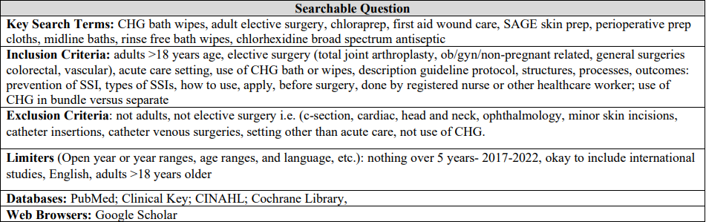
Phase 2- Search for the Best Evidence
Plan a search strategy/methodology:
  Determine what database(s) to search
  Identify your key words
  Collaborate with your clinical librarians and expert EBP mentors and resources

Slide 10
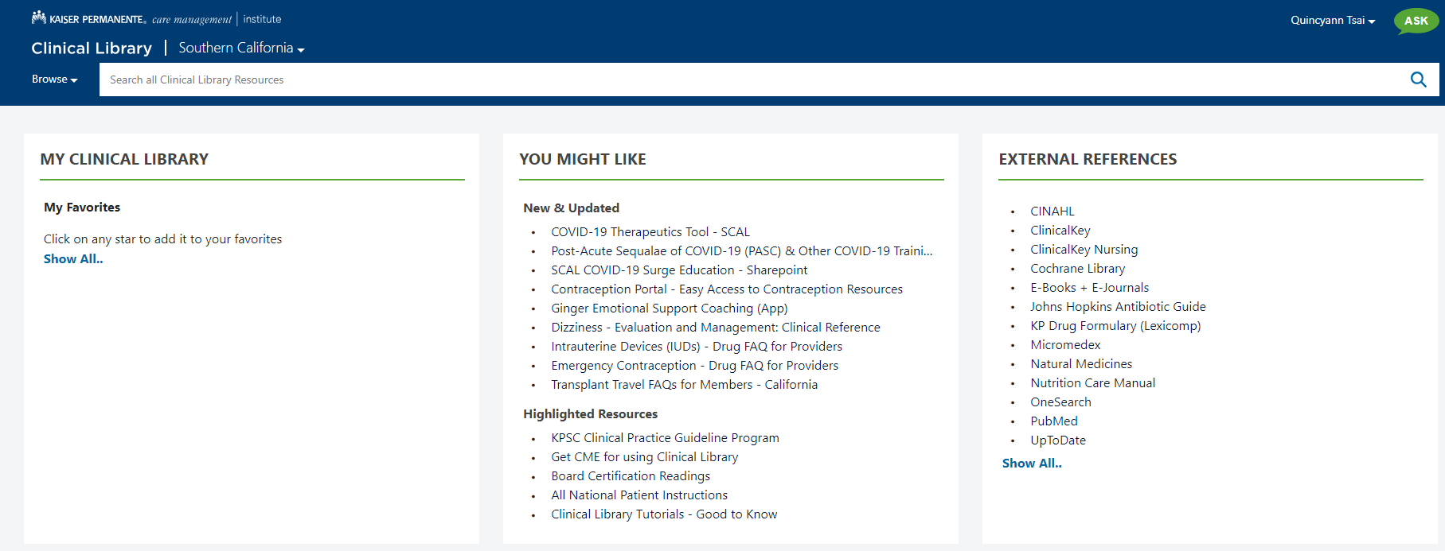
Kaiser Permanente Clinical Library
Phase 2: Conduct a literature search

Slide 11
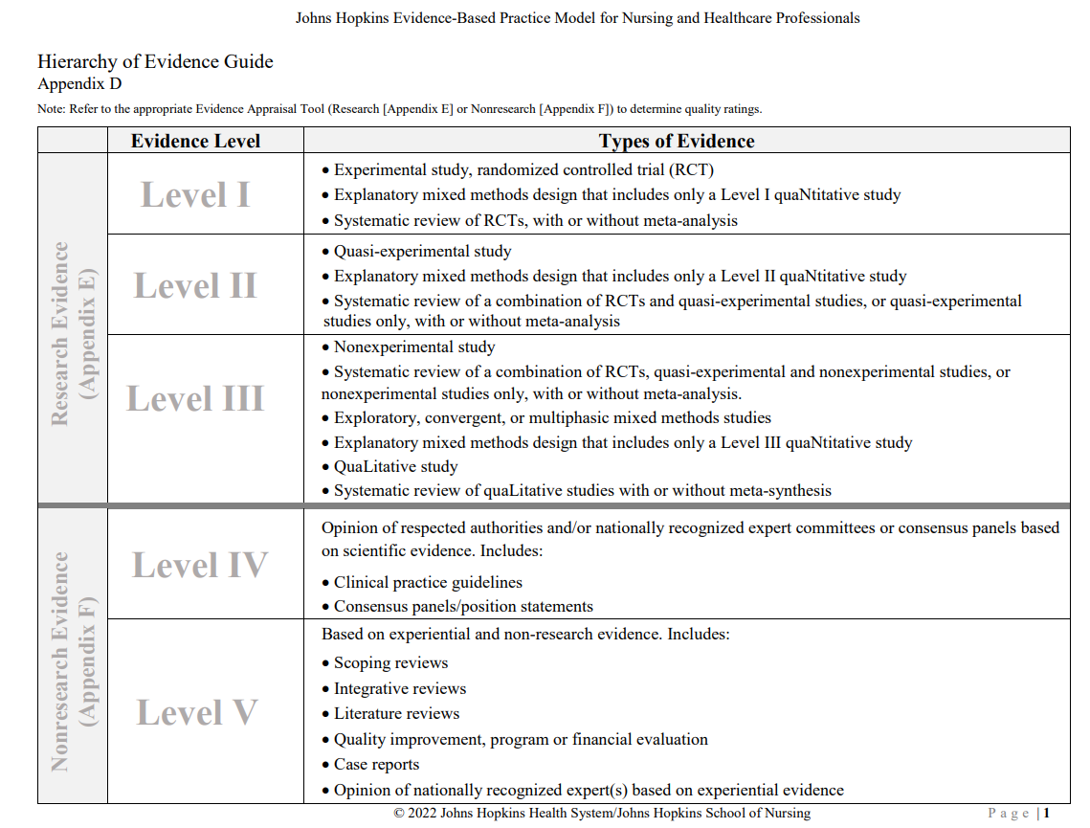
Hierarchy of Evidence
Phase 2: Evidence appraised for Strength + Quality

Slide 12
Academy of Evidence Based Practice (EBP)
Evidence Leveling System (ELS)
Step 3: Critically appraise the evidence
Academy of Evidence Based Practice© (EBP) Evidence Leveling System (ELS)
LEVEL | DESCRIPTION | RELEVANT ARTICLES | ARTICLE NUMBER
A | Meta-analysis of multiple large sample or small sample* randomized controlled studies, or meta-synthesis of qualitative studies with results that consistently support a specific action, intervention, or treatment
B | Well-designed controlled studies, both randomized and nonrandomized, prospective or retrospective studies, and integrative reviews with results that consistently support a specific action, intervention, or treatment
C | Qualitative studies, descriptive or correlational studies, integrative reviews, systematic reviews, or randomized controlled trials with inconsistent results
D | Peer-reviewed professional organizational standards, with clinical studies to support recommendations
E | Theory-based evidence from expert opinion or multiple case reports, case studies, consensus of experts, and literature reviews
MA | Manufacturer’s recommendation; Anecdotes
LR | Laws and Regulations (local, state, federal; licensing boards; accreditation bodies, etc.)
 | Total

Slide 13
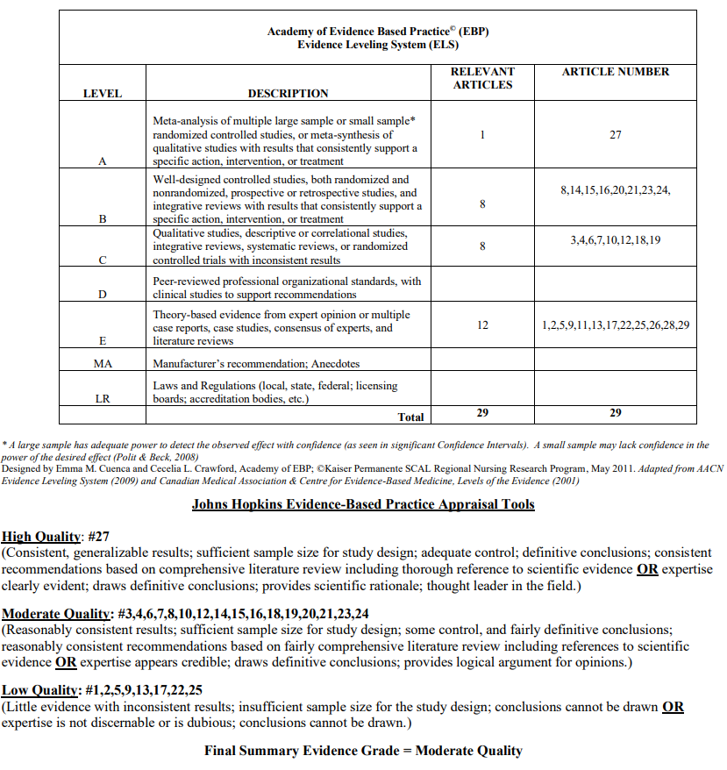
Utilizing the Johns Hopkins Evidence-Based
Practice Appraisal Tools (2017)

Slide 14
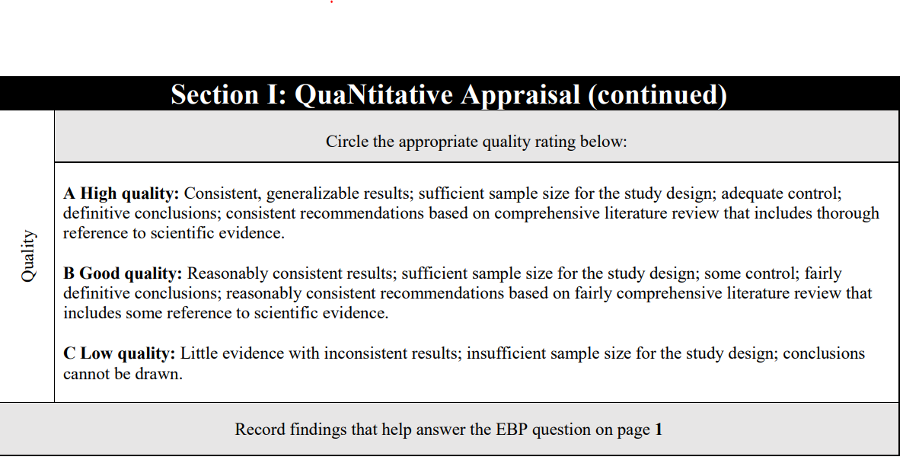
Phase 2: Determine Quality of the Evidence
(Johns Hopkins Healthy System/Johns Hopkins School of Nursing, 2022)

Slide 15
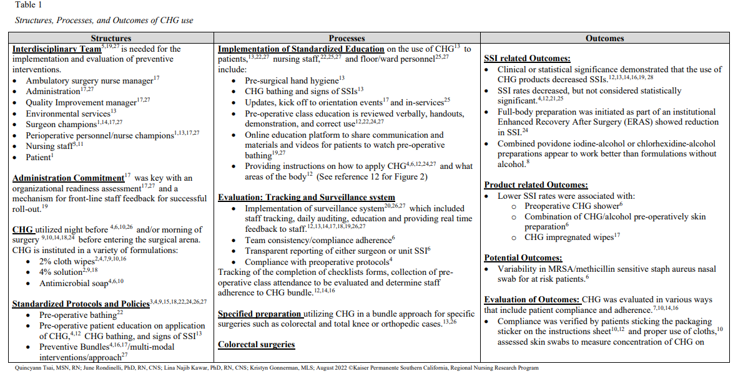
Phase 3: Translating the Evidence into Practice

Slide 16
References
Dang, D., Deaholt, S., Bissett, K., Ascenzi, J., & Whalen, M. (2022). Johns Hopkins evidence-based practice for nurses and healthcare professionals: Model and guidelines. 4th et. Sigma Theta Tau International. Retrieved on June 10, 2023 from Evidence-Based Practice | Institute for Johns Hopkins Nursing (hopkinsmedicine.org)
Johns Hopkins Evidence-Based Practice Series, 2022 Edition https://www.ijhn-education.org/node/19146#group-tabs-node-course-default5
Kawar, L.N., Aquino-Maneja, E.M., Flores, S.L., & Squier, V.R. (2023). Research, evidenced-based practice, and quality improvement simplified. The Journal of Continuing Education in Nursing, 54, (1), pp. 40-48.
Melnyk, B., & Fineout-Overholt, E. (2011). Evidence-based practice in nursing and healthcare: A guide to best practice (2nd ed.). Wolters Kluwer.
Melnyk, B.M., Gallagher-Ford, L., Long, L.E., Fineout-Overholt, E. (2014). The establishment of evidence-based practice competencies for practicing registered nurses and advanced practice nurses in real-world clinical settings: Proficiencies to improve healthcare quality, reliability, patient outcomes, and costs. Worldviews on Evidence-Based Nursing, 11,(1), pp. 5-15.
Polit, D. F., & Beck, C. T. (2021). Nursing research generating and assessing evidence for nursing practice (11th ed.). Wolter Kluwer.

