Slide 1
Research and Statistics
Session 9: Logistic Regression

Slide 2
Logistic Regression
In this session, we’ll cover Logistic Regression.
We can answer the questions, “What is logistic regression?” and “What were my chances on the Titanic?”

Slide 3
What is Logistic Regression?
Logistic Regression is a “general linear model” for estimating the relationships (coefficients) between the independent and dependent variables (or outcomes).
Some variables may increase our chances while others decrease it.
Logistic Regression is similar to Linear Regression.
How it differs is that it is a probability model. Because probabilities can be converted into odds, we also get Odds Ratios in our results. E.g., women are 12 times more likely than men to survive the Titanic.

Slide 4
Logistic regression is a probability model
Probabilities are everywhere: Getting a head in a coin toss, winning the lottery, chances of a hospital acquired condition, etc.
We can start by assigning the outcome’s overall average as our chances (probability). For example, each passenger has a probability of 0.38 or a 38% chance for surviving the Titanic.
We can add in other important factors that gives us a better picture of our chances such as gender (female=0.73, male=0.19 rather than 0.38 for everyone)
These are probabilities (or percentages, e.g., 73% chance of women surviving the Titanic).

Slide 5
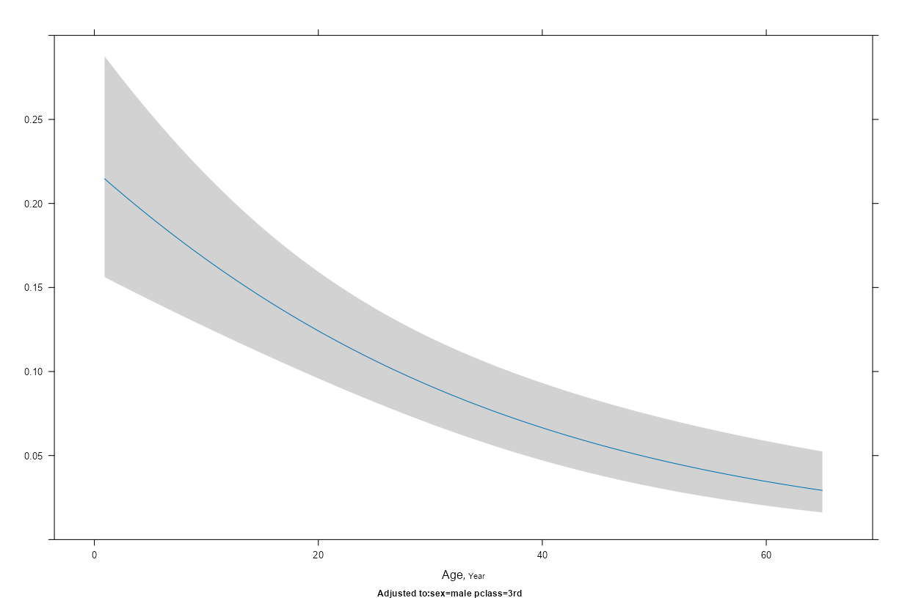
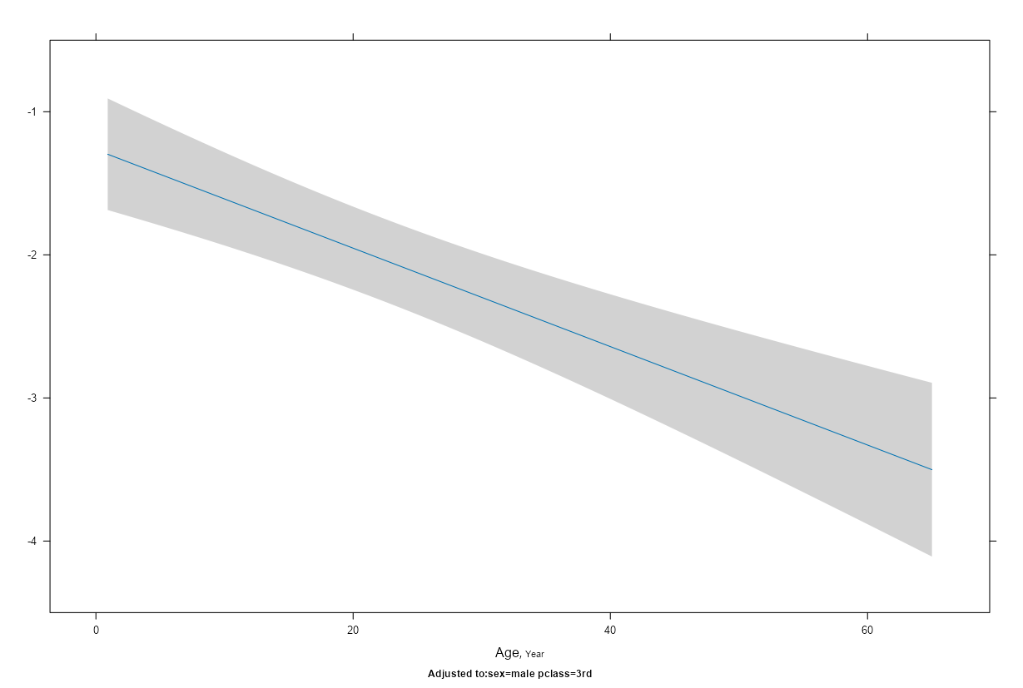
Using logits allows us to see linear trends (i.e., straight lines)
Using probabilities
Using logits
We can’t use linear regression for binary outcomes because it can give us impossible results like having 110% sepsis or -10% dead
Logits range from – Infinity to + Infinity. 0 = a 50% chance.
No option for a straight line, one of our assumptions in logistic regression.

Slide 6
Surviving the Titanic (N = 1,046)
Conceptual model: Survival = Age + Gender + Passenger Class

Slide 7
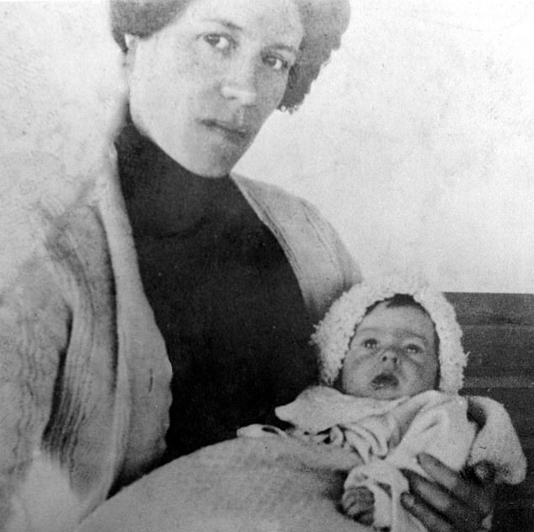
Millvina Dean (the youngest and last survivor of the Titanic)
It really was a case of women-and-children first but we hear her say that passenger class made a very big difference. We can test these hypotheses.
(Part 2) Millvina Dean: Inspiring Interview with Titanic's Youngest Survivor 🚢💪 #Titanic #History

Slide 8
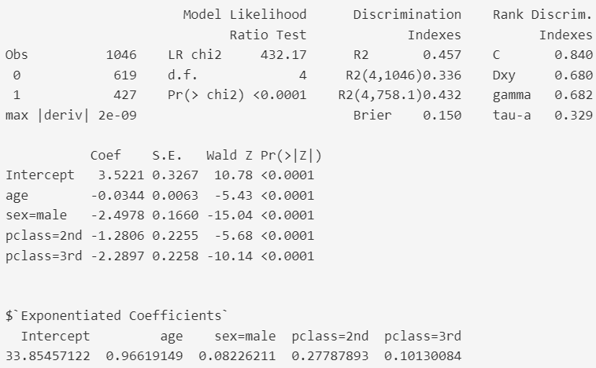
Interpreting model results. We are testing if the coefficient B = 0 (H0: B=0).
A concordance (C) statistic is also the area under the curve (AUC).
AUC >= 0.80 is very good and at a level where we can reliably make predictions.
Age: For every 1-unit increase, a decrease in survival by 3.4%
(1 - 0.966 = -0.034).
Sex: Men have a 91.8% lower chance, controlling for all other variables.
All 3 predictors have very low p-values. There is a very low chance of us being wrong about there being significant differences and we can safely reject the null hypothesis.
Passenger class: 2nd and 3rd class have much lower odds of surviving than 1st class. E.g., 3rd class has 1/9 the odds of 1st :
0.10 / (1 - 0.10)

Slide 9
How to convert logits to odds ratios and probabilities of survival
Simple logistic regression (i.e., 1 predictor)
Coefficients
Intercept (Female): 0.98
Male: -2.43
To get the odds ratios, we 'exponentiate' the logit values
Male odds ratio: exp(-2.43) = 0.09
Because values less than 1 aren't as easy to understand, providing the female odds ratio is a little more informative
To get the Female odds ratio, we calculate the inverse value (i.e., 1/exp(x) ). 1/exp(-2.43) = 11.31
We can now calculate the probability of surviving for men and women.
Add the logits and exponentiate.
Remember the intercept (0.98) represents females and the variable sex is the "male effect". So male logits are 0.98 + -2.43 = -1.44.
Use the formula: exponentiated X/ (1 + exponentiated X)
Female: exp(0.98)/(1 + exp(0.98)) = 0.73
Male: exp(-1.44)/(1 + exp(-1.44)) = 0.19
More predictors, add their average logits

Slide 10
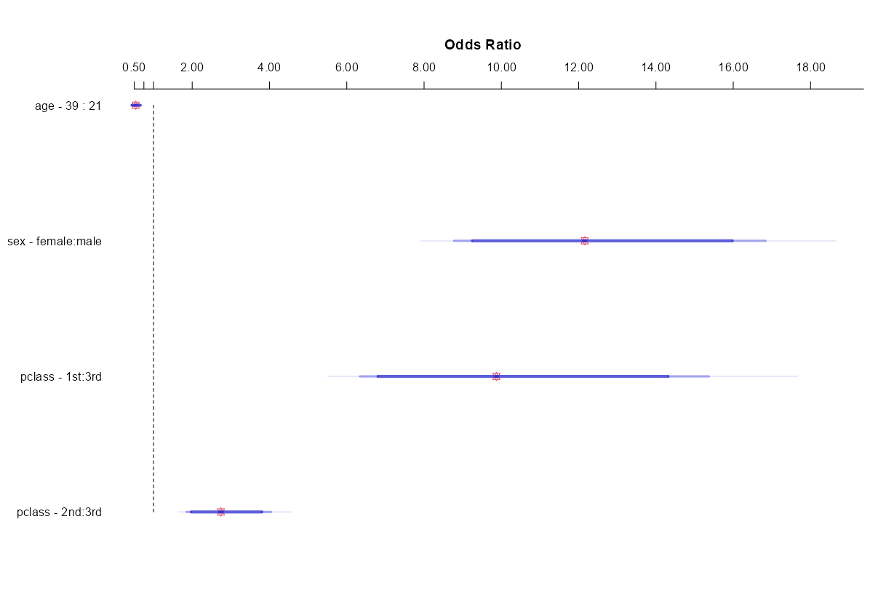
Older passengers had lower odds of survival, going from the 1st quartile to the 3rd cut their odds in about half
Age
Women’s odds of survival are about 12 times higher than men
Sex
Class: 1st
1st class passengers’ odds of survival are over 9 times higher than 3rd class and 2nd class is more than twice that of 3rd class
Class: 2nd

Slide 11
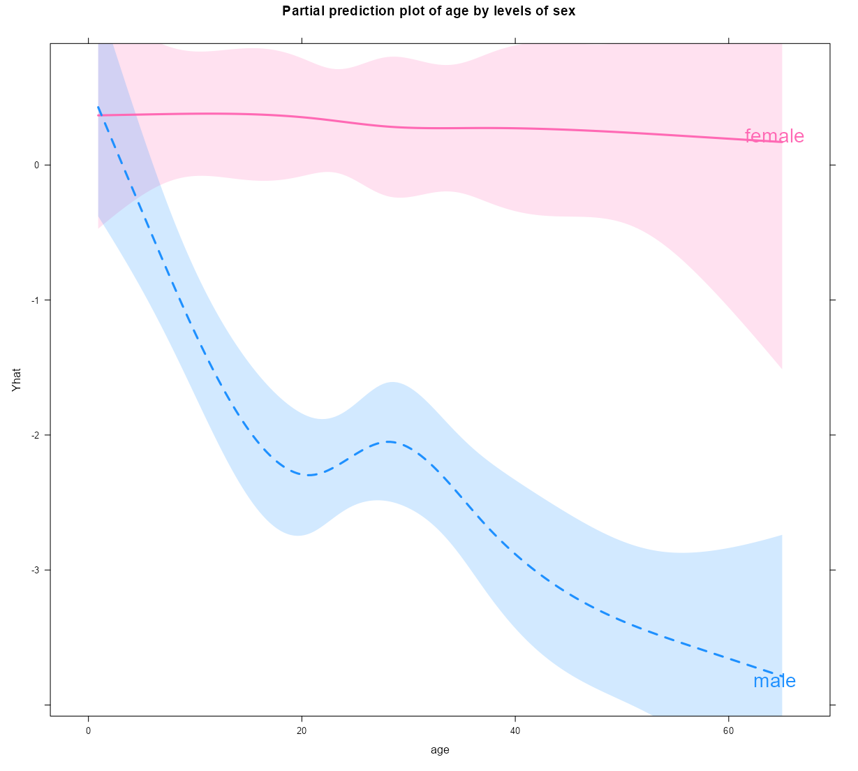
Trend lines for men and women by age
Women generally have chances above 50% at any age. The pink trend line is above a logit of 0 which is where 50/50 chances are at. Age was more of an issue for men.
The youngest passenger (9 weeks) had a 77% chance of surviving while her 26-year-old father had a 10% chance
Relaxing Linearity and Additivity assumptions lets us get separate curves for men and women

Slide 12
Summary
Logistic regression allows us to examine binary outcomes (e.g., 0 or 1, Yes or No, True or False).
Logistic Regression allows us to control for multiple variables. We rarely get to do true experiments in healthcare so we use observational studies instead. We then control for other important variables and test our hypotheses. Our “model” is the collection of various independent variables.
We get results as logits. We can convert those to odds ratios & probabilities.
There will never be another Titanic but her sister-ship Britannic sank 4 years later. The 30 who died would have been predicted most likely to survive, their lifeboats were pulled under (i.e., they are different samples).
Learn more at this link StatsWithSteve Team

Slide 13
Knowledge check
True or false? Logistic regression is a way to analyze binary outcomes (e.g., Yes/No, 0/1):
True
False
2) Select the correct answer(s). The results of a logistic regression allows us to:
Use logits to form trend lines.
Calculate odds ratios.
Calculate probabilities.
All of the above.

Slide 14
Knowledge check --
Answers
True or false? Logistic regression is a way to analyze binary outcomes (e.g., Yes/No, 0/1):
True
False
2) Select the correct answer(s). The results of a logistic regression allows us to:
Use logits to form trend lines.
Calculate odds ratios.
Calculate probabilities.
All of the above.

Slide 15
Appendix
Odds ratios and probabilities

Slide 16
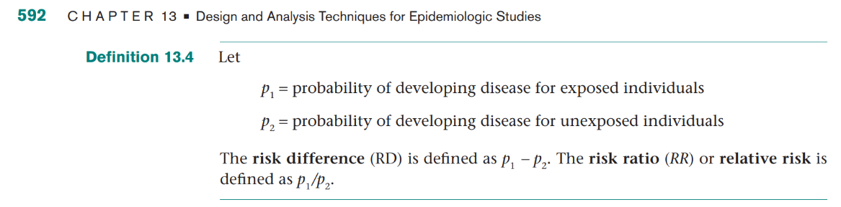
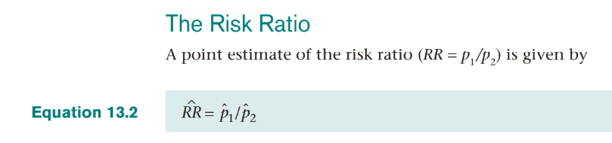
Working with probabilities from binary outcomes: Risk difference and Risk Ratios (or Relative Risk)
These are commonly used statistics but we use Odds Ratios because of their more flexible statistical qualities.
For example, if P1= 0.40 and P2= 0.20, then:
Risk Difference = 0.20 (0.4 – 0.2)
Risk Ratio = 2.00 (0.4 / 0.2)

Slide 17
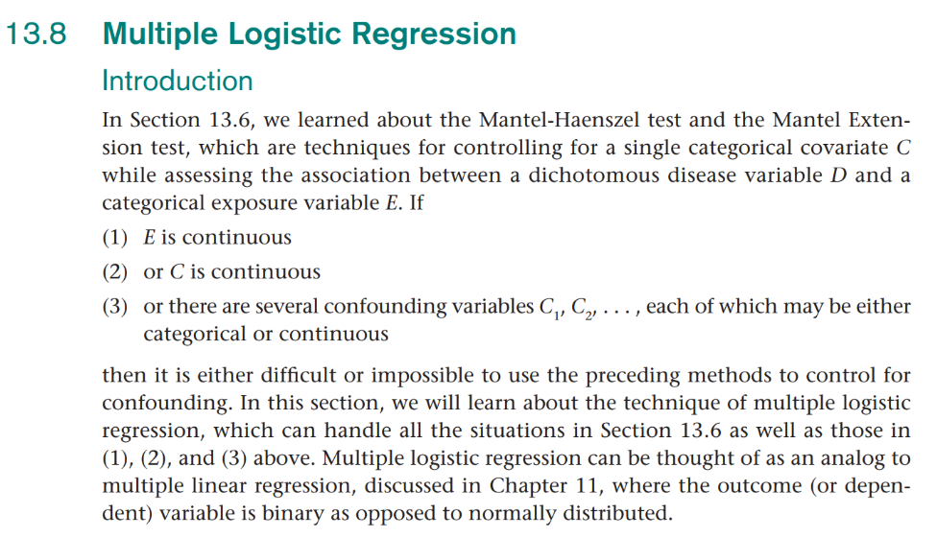
Logistic Regression
Common binary (or 2-level outcomes):
Death, Readmission, Infection, Heart Disease, Cancer, Missed appointment, etc.

Slide 18
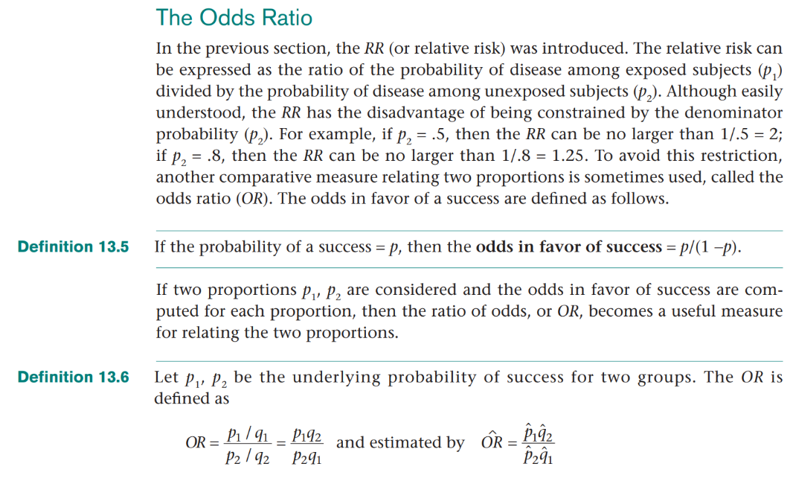
The Odds Ratio
The RR’s denominator range is limited so we use the Odds Ratio instead.
We can convert probabilities into odds (e.g., 0.80/(1 – 0.80) = 4.
The Odds Ratio is calculated as the: Odds 1/ Odds 2.
p= Probability of A
q= Probability of not A

Slide 19
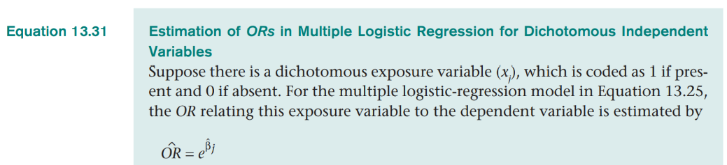
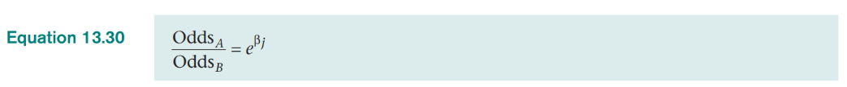
Logistic Regression gives us Odds Ratios

Slide 20
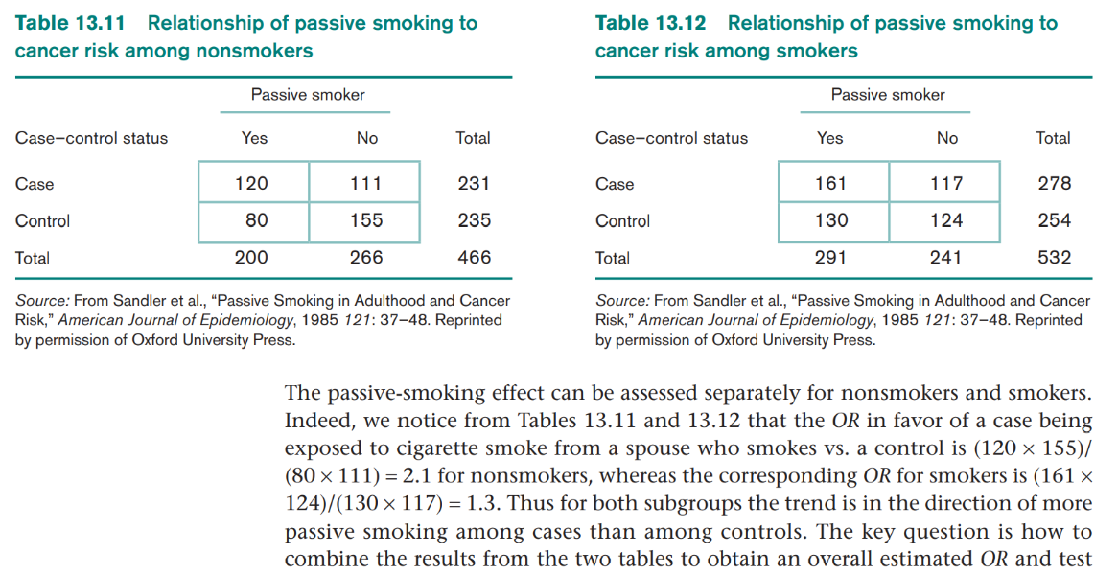
Odds Ratio example on passive smoking (2nd hand smoke) and lung cancer (= “Case”)
Alt formula: OR =(120/111) / (80/155) = 2.1
The Odds Ratio of “Passive Smokers with lung cancer” to “Passive Smokers without lung cancer” is 2.1. PS (non-smokers) are twice as likely to have lung cancer .

Slide 21

Various Odds Ratio calculations for the exposure (or factor)
We can use proportions, whole numbers, and multiplication to get the same odds ratio. See data table below.
1. Proportions: [(339/466)/(127/466)] / [(161/843)/(682/843)]= 11.3 Odds Ratio = (0.73/0.27) / (0.19/0.81) = 2.67 / 0.23 = 11.3
2. Whole Numbers: Odds Ratio = (339/127) / (161/682) = 11.3
3. Multiplication: Odds Ratio = 339*682 / 127*161 = 11.3
All 3 gives us the Odds Ratio of women surviving compared to men surviving.
Survived = 1

Slide 22
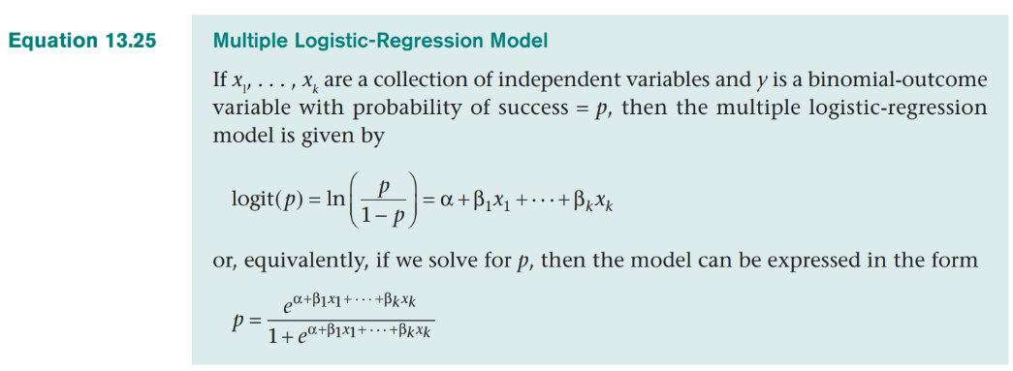
Logistic Regression is a probability model
The left side of “=“ is the transformed probability.
Everything on the right side of “=“ are the predictor variables.
Because of the mathematical correspondence of 1) logits, 2) odds ratios, and 3) probabilities, we can get 3 types of results.

Slide 23
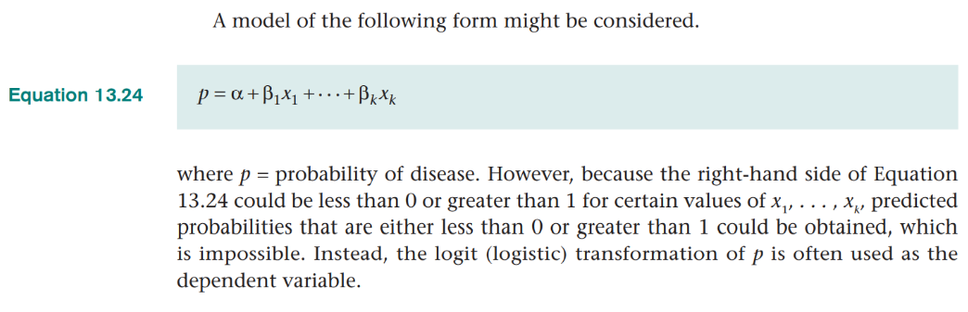
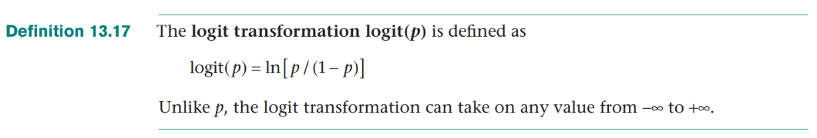
We can’t use probability as an outcome in Linear Regression so we use Logistic Regression instead.

Slide 24
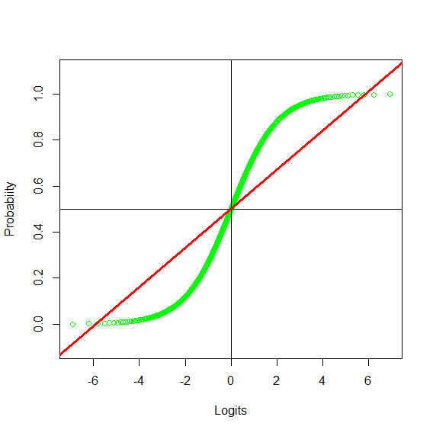
Relationship between Logits and probabilities
Logistic Regression allows us to get linear trends that stay within probabilities of 0-to-1.
The green line represents logits that are properly constrained within 0 and 1. Notice extreme values on both ends get pulled in.
Using logit transformations solves the dilemma of getting credible estimated values from a regression.
The red line represents values that are not constrained and they can exceed the true limits of 0 and 1 in multiple linear regression.

Slide 25
What do we get from a logistic regression?
Logits, Odds Ratios, and Probabilities.
Logits or natural logs: They allow us to have a linear additive model similar to multiple linear regression. For example, we can graph the age trend
Odds Ratios: We can exponentiate our log odds values to let us know the odds in favor of death are 2 times higher for men than women. These are most helpful in explaining the results of each predictor.
Probabilities: We can sum our risk and determine that men have a 0.20 (or 20%) risk of readmission. These are most helpful in summarizing total risk.

