Slide 1
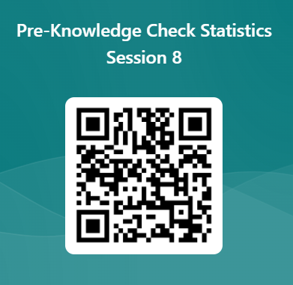
Statistic Session 8 Pre-Knowledge check
https://forms.office.com/r/4SNtN4dMvk

Slide 2
Research and Statistics
Session 8: Linear Regression

Slide 3
Linear Regression
In this session, we’ll cover Simple and Multiple Linear Regression.
We can answer the questions, “What is regression?” and “Why use regression?”

Slide 4
Glossary
Regression: The process of defining an outcome by one or more predictive variables. For continuous outcomes, we often use the “ordinary least squares” method to calculate regression coefficients. Also referred to as simple linear or multiple linear regression.
Model: The set of variables used to explain the outcome of interest. For example, life expectancy might be modeled as: Years lived = Gender + health status.
Coefficients: These are the regression weights used to calculate model predictions. For example, in a model that predicts weight, a height coefficient of 2 indicates that for every added inch in height, it adds 2 pounds to predicted weight.
“Y”: Outcome variable, response variable, or dependent variable.
“X”: Predictor variable(s), explanatory variable(s), or independent variable(s).
R-Squared (R^2, R2): The proportion of variance of the outcome accounted for by the predictors, model reliability. i.e., how well the trend line aligns to the actual data points.​ More alignment= higher R^2.

Slide 5
Motivation for multiple linear regression
There are 2 approaches in testing hypotheses : 1) Balance our sample on all important things and then test (e.g., correlation or t-test) or 2) gather data on all important things, then balance mathematically when we test.
#1 is called an “experiment” and #2 is an “observational study”. Observational studies always work in health care. Experiments with randomization can be impractical or even unethical in health care.
Regression allows us to simultaneously test relationships, reducing Type-I errors. Otherwise, we would need to do separate tests.

Slide 6
Linear Regression (Ordinary Least Squares)
Regression: Regressing the outcome on one (simple) or more predictors (multiple).
Linear: Refers to a line that best represents the association between the outcome and the predictor (Y ~ X).
Outcomes: In ordinary least squares, the outcome is continuous. These are variables with many values (e.g., length of stay, cost, etc.). Predictors can be continuous or categorical variables.
We can use regression for 3 purposes: 1) Hypothesis testing, 2) effect size estimation—e.g., cost savings from intervention, and 3) predictive modeling—e.g., predicted LOS based on patient info.

Slide 7
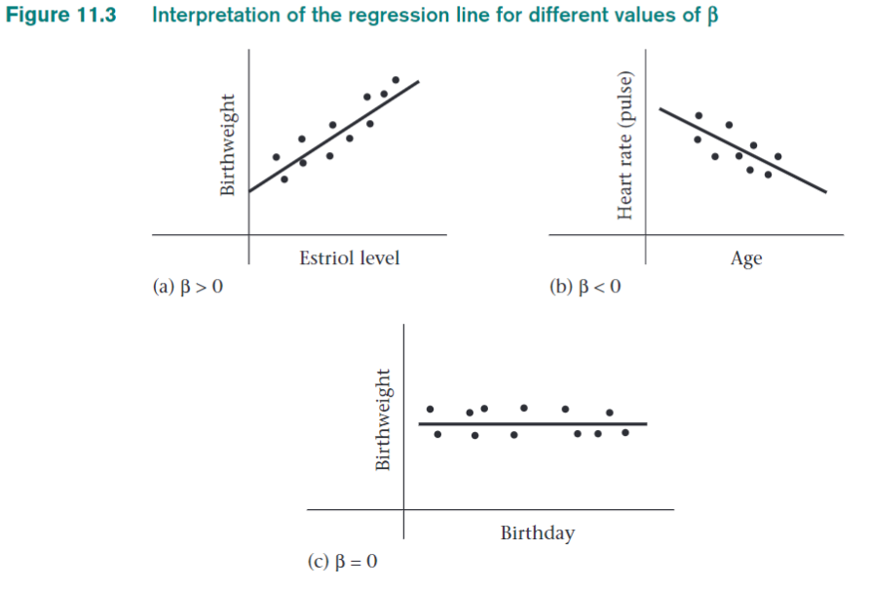
As mother's estriol levels increases, the average baby birthweight increases.
As baby ages get older, their heart rates slow down.
Y
X
Y axis= Outcome
X axis= Predictors
We graph trend lines, the bottom left corner is where both X and Y= 0.
Rosner, p. 430
There is no relationship between birthday and birthweight, the trend is flat.

Slide 8
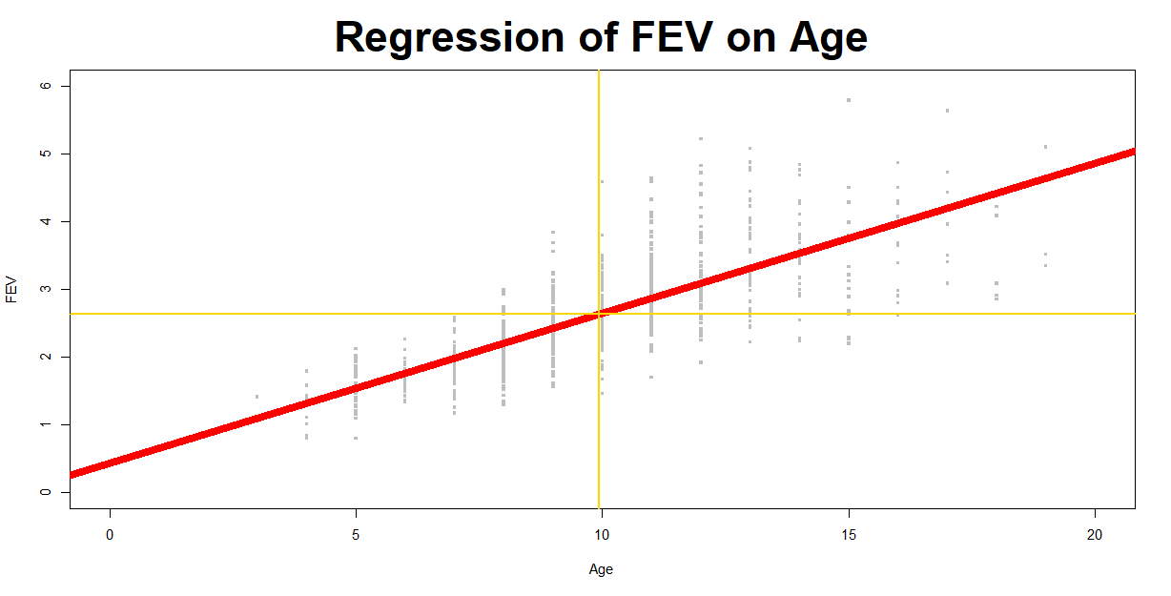
Simple Linear Regression trend line--Pediatric Forced Expiratory Volume (breathing test)
For each increment of 1, the line goes up by 0.22 (e.g., at age = 10, FEV is expected to be 2.2 points higher than Age=0 at 2.63).
These values are always in a trend line:
FEV mean= 2.6
Age mean= 9.9
From our results, we get an “Intercept” of 0.43.
This significant trend line has an R2 = 0.57. This reflects a moderate amount of clustering of gray data points around the red line (i.e., the line does a fairly good job of representing the relationship between FEV and Age).
FEV = 0.43 + 0.22 * Age

Slide 9
Regression Assumptions & Diagnostics
Linearity: The relationships between the predictors and the outcome variable is linear. This assumption can be relaxed with the use of nonlinear regression terms, Y = A + B + B^2.
Additivity: The impact of different covariates is additive, Y = A + B1 + B2. This assumption can be relaxed by using interactions,
Y = A + B1 * B2.
Independence: The errors associated with one observation are not correlated with the errors of any other observation.
Normality: Errors are normally distributed. We can observe with histograms and examine residuals.
Homogeneity of variance (homoscedasticity): The error variance should be constant across levels of X. Check residual graphs.
Model specification: The model is specified correctly. This is based on your judgement (i.e., “Did I include the important variables?”).

Slide 10
Steps in Regression
Research design
Data collection: Don’t categorize continuous predictors when possible, get wide distributions. Use well defined groups.
Descriptive statistics, examine outcome means by quartiles or categories.
Run and assess the model.
Diagnostics and revisions (if needed).
Interpret results.
Consider strategies: 1) Data reduction to avoid collinearity, 2) identify outliers, 3) use N/15= variables to avoid overfitting.

Slide 11
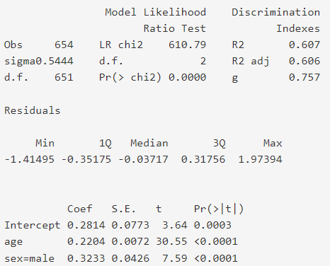
Interpreting model parameters. We are testing if the coefficient B = 0 (H0: B=0).
The model fits the data well (R2 = 0.61).
Intercept: The FEV of 0.28 is when all predictors = 0.
Intercept: This is almost always significant.
Age: For every 1-unit increase, there is an increase in FEV by 0.22, controlling for all other predictors (i.e., Sex).
Age: This is very significant, i.e., the confidence interval on coefficients does not contain 0 as a possibility.
Sex: For males, there is an increase in FEV by 0.32 compared to females, controlling for all other predictors (i.e., Age).
Sex: This is also significant. We feel confident that males have significantly higher FEV levels than females.

Slide 12
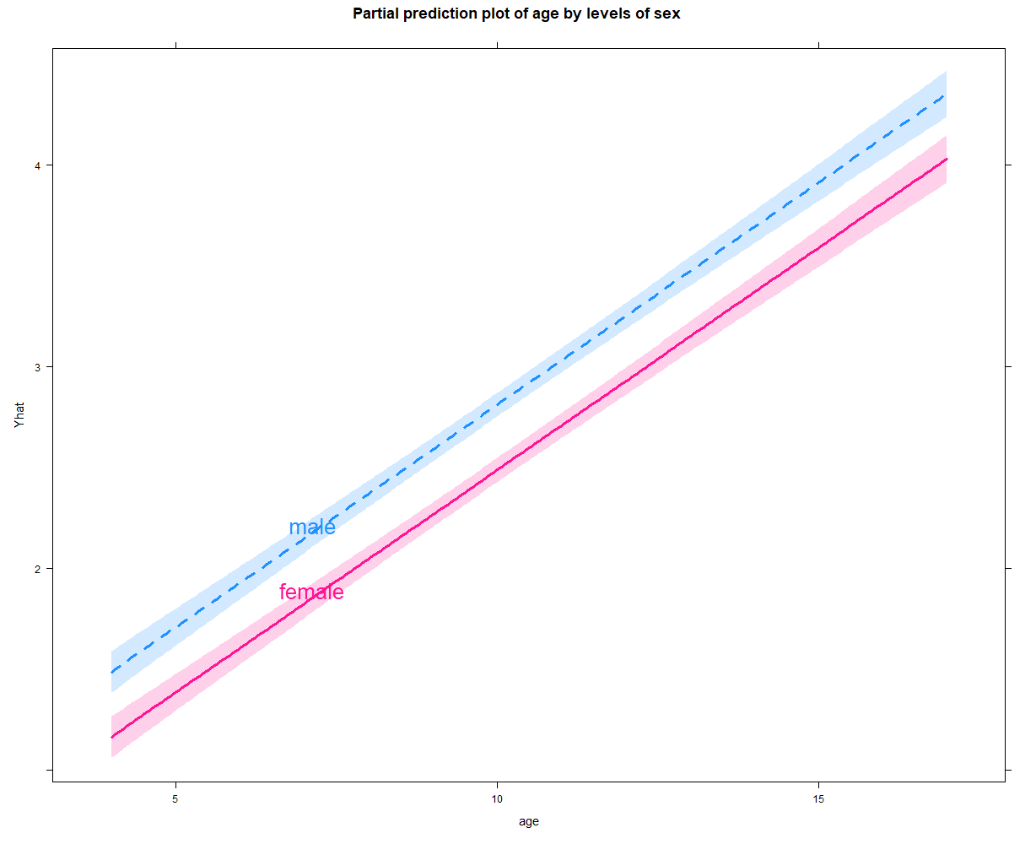
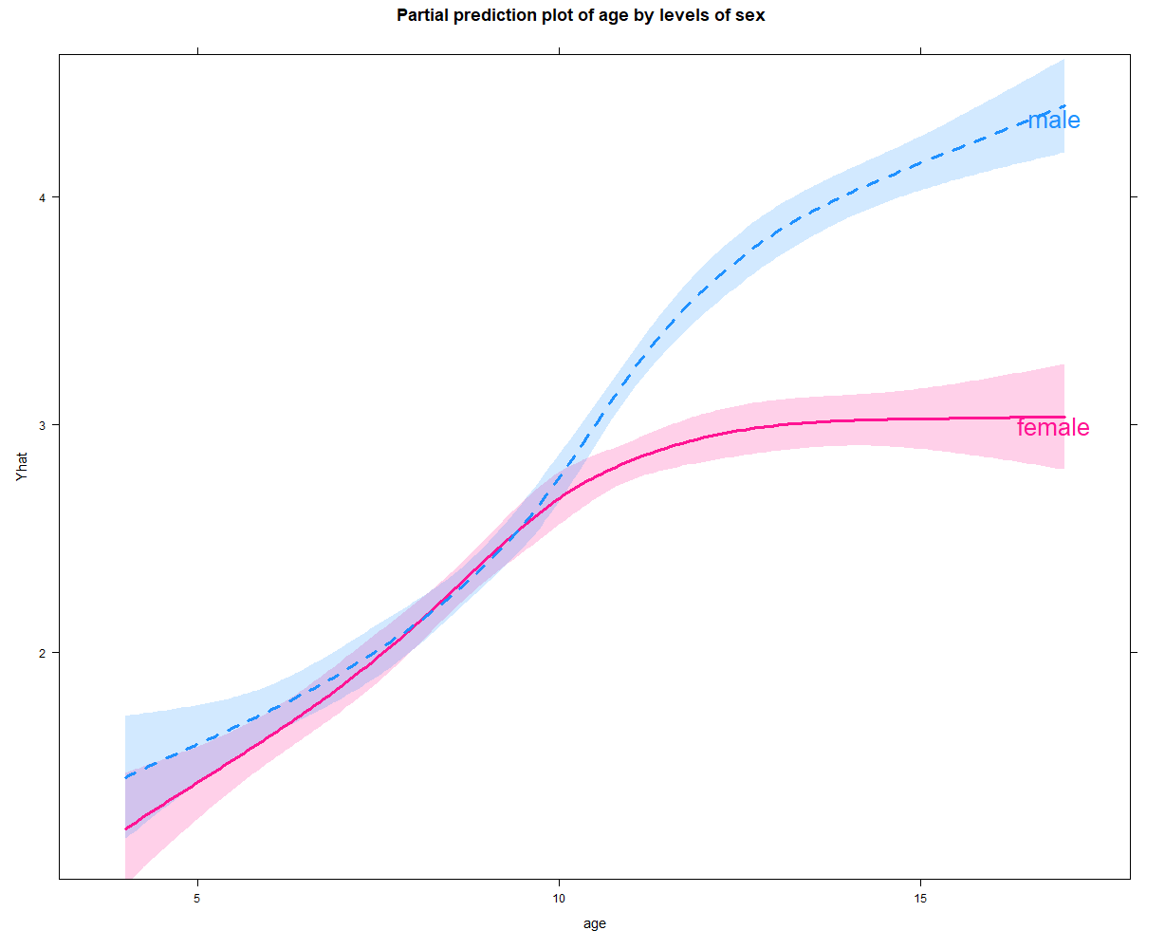
Relaxing Linearity and Additivity assumptions to get more powerful regression models
Age trend lines for Boys and Girls
R2 significantly increased from 0.61 to 0.68 in the new model.
Relaxing linearity : Using squared terms Age + Age^2. Relaxing additivity: Using Age*Sex interaction. This gives a more informative model (e.g., trends look different after age 10).

Slide 13
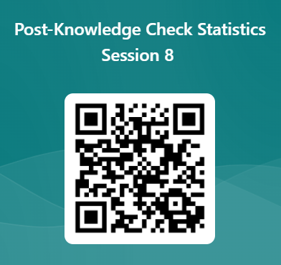
Statistic Session 8 Post-Knowledge check
https://forms.office.com/r/bPnDSpPWPP

Slide 14
Knowledge check
Which type of regression best describes when we have 2 predictor variables?
Simple linear regression.
Multiple linear regression.
2) Select the correct answer(s). What are some of the defining characteristics of regression? (Select all that apply)
Coefficients can be used to form a trend line.
It mathematically allows us to estimate effects while controlling for other variables.
Uses R2 to assess model fit.
All of the above.

Slide 15
Knowledge check --
Answers
Which type of regression best describes when we have 2 predictor variables?
Simple linear regression.
Multiple linear regression.
2) Select the correct answer(s). What are some of the defining characteristics of regression? (Select all that apply)
Coefficients can be used to form a trend line.
It mathematically allows us to estimate effects while controlling for other variables.
Uses R2 to assess model fit.
All of the above.

