Slide 1
Research and Statistics
Session 7: Measurement and Assessment

Slide 2
Measurement and Assessment
In this session, we’ll cover scales, cluster analysis, and factor analysis.
We can answer the question, “Is my factor reliable and valid?”

Slide 3

What is measurement and assessment?
A different field within statistics.
We develop a measure and assess its accuracy in measuring the phenomena we are interested in (i.e., we assess our measure).
Reliability: How reliable our measure is in producing consistent values of our factor (e.g., Cronbach’s Alpha).
Validity: How valid is the factor a measure of the phenomena we are interested in. In other words, is it measuring what it is supposed to measure (e.g., Confirmatory Factor Analysis).

Slide 4
Types of measurement examples
Behavior and beliefs (e.g., risk health behaviors, political beliefs).
Cognitive aptitude and achievement (e.g., SATs).
Assessment of mental illness (e.g., borderline personality disorder).
FBI suspect profiling (e.g., psychometrics).
Data reduction: Combining colinear or highly correlated variables into a single factor to prevent “over-fitting” in a regression (e.g., combining heart rate, mean blood pressure, and age to represent a factor of “health status”).
Test if a factor “loads” up on specific variables in the way we expect.
Use survey responses of multiple items to form single factors on beliefs of “Evidence Based Practices” in Nursing (e.g., 5-point Likert scale).

Slide 5
Analysis examples
Hierarchical Cluster Analysis to identify variables that measure similar dimensions.
Dendrogram to display Hierarchical Cluster Analysis results.
Principal Components Analysis as a form of “Data Reduction” of variables in a regression model (e.g., combining 8 variables into 1 to reduce the complexity of the model).
Cronbach’s Alpha of a 5-point Likert scale (“Strongly Disagree” to “Strongly Agree”) to assess reliability.
Factor Analysis of multiple variables to identify which variables are tapping into the same unobservable dimension (i.e., Exploratory Factor Analysis).
Confirmatory Factor Analysis to see if specific variables tap into the same dimension (i.e., validity).

Slide 6
Principal Components Analysis
Collapsing many highly related variables into 1 variable can make the analysis more reliable and provide more accurate results.
Hierarchical Cluster Analysis allows us to see which variables (or patients) have similar response patterns.
Dendrograms let us view which variables are most correlated
Scree plots can help us determine how many factors we have. We then use our HCA results to determine the factors.

Slide 7
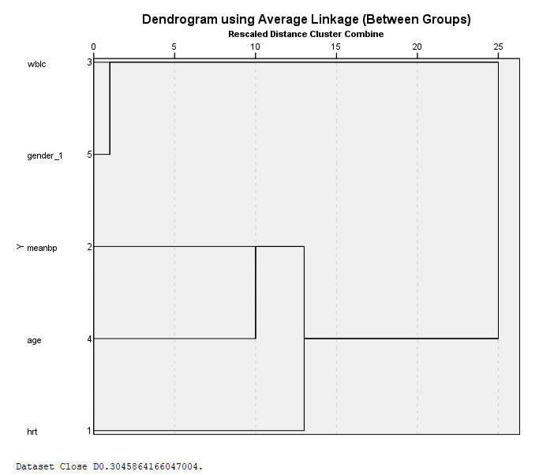
Hierarchical Cluster Analysis and Dendrograms
The dendrogram allows us to see which variables tend to have similar response patterns (i.e., correlated).
The HCA lets us detect factors such as the link between age, heart rate, and blood pressure.
For example, older patients tend to have lower heart rates.

Slide 8
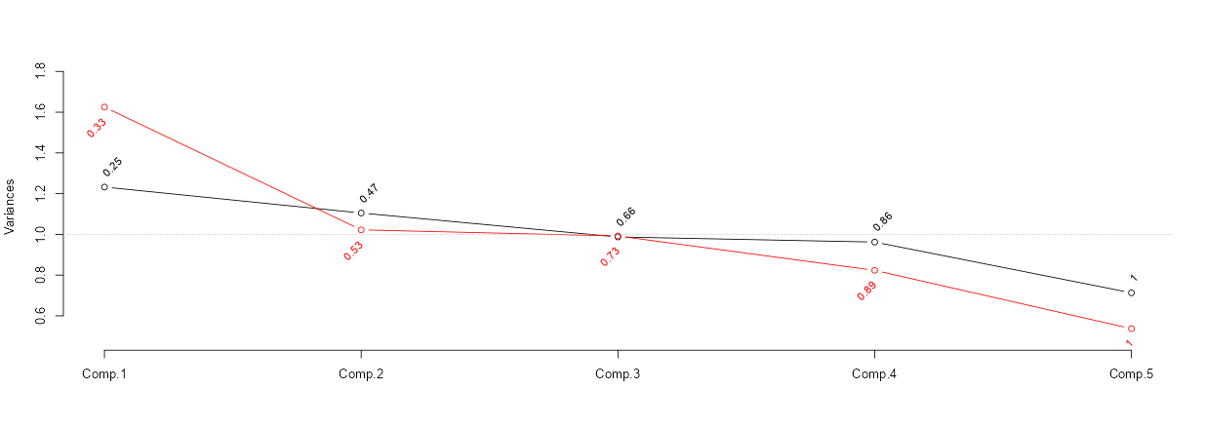
Principal Components Analysis: Scree Plot
Scree Plot: The cumulative proportion of variance explained by each component using all predictors in the model (e.g., the first 2 components explain 47% using raw scores— 53% for transformed scores in red).
Scree plots help us identify the number of factors in our data. Here we have 2. When components have Eigenvalues <= 1, there is no benefit in having those additional factors.
Eigen-value threshold of 1

Slide 9
Scales
Scales measure the level of behaviors or beliefs.
Scales are often used in survey research.
Common scales are 5-point Likert scales (e.g., “strongly agree”) but can be cumulative check lists like Guttman scales.
A common method for assessing Likert scales is the Cronbach’s Alpha which is an extension of correlations.

Slide 10
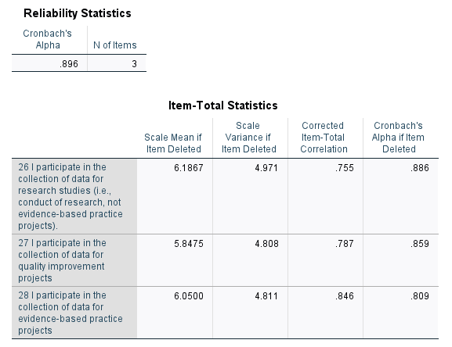
Cronbach’s Alpha
Cronbach’s Alpha assesses the reliability of multiple items in measuring the same dimension.
Alpha ranges from 0 to 1.
Common thresholds for high, moderate, and low reliability are 0.80, 0.60, and <0.60.
To the left, we see the Alpha level is quite high, 0.90. This indicates that the 3 measures reliably measure “Data Collection”.

Slide 11
Confirmatory Factor Analysis
PCA and factor analysis “finds” factors in the data. Confirmatory Factor Analysis tests the “factor loadings” of specific variables.
A major concern with PCA is that it tries to account for all the variance and covariance of the set of items rather than for the individual items (i.e., not all items are equal).
Values range from -1 to 1. Factor loadings are “good” at 0.4/-0.4 or stronger.
Advantages of CFA: By isolating the shared variance of the multiple items from the unique variance, we’re able to obtain a better measure of the latent variable (i.e. factor).

Slide 12
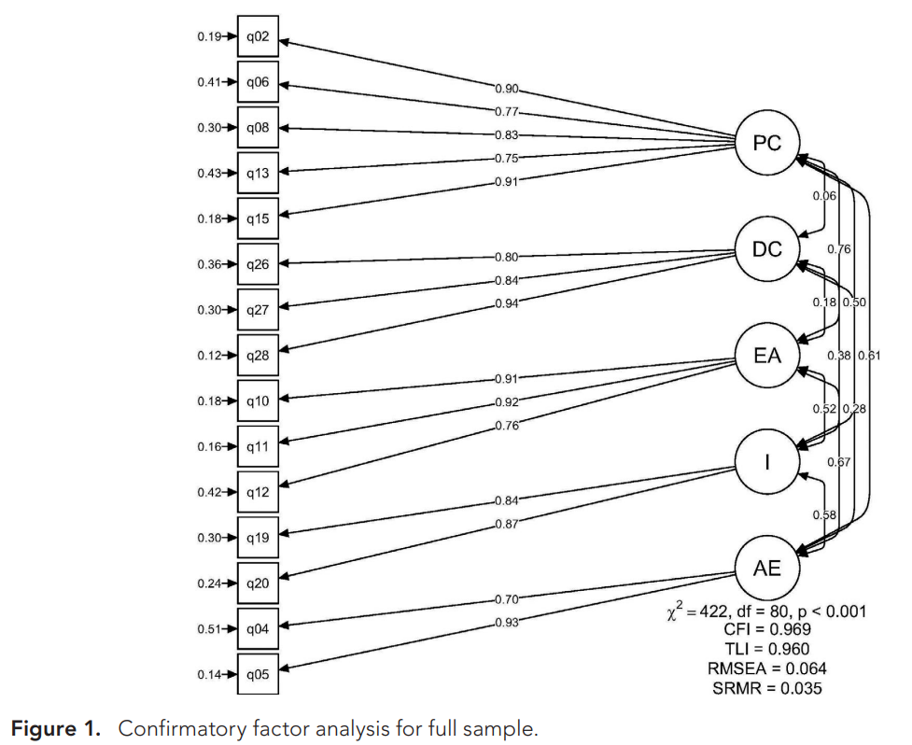
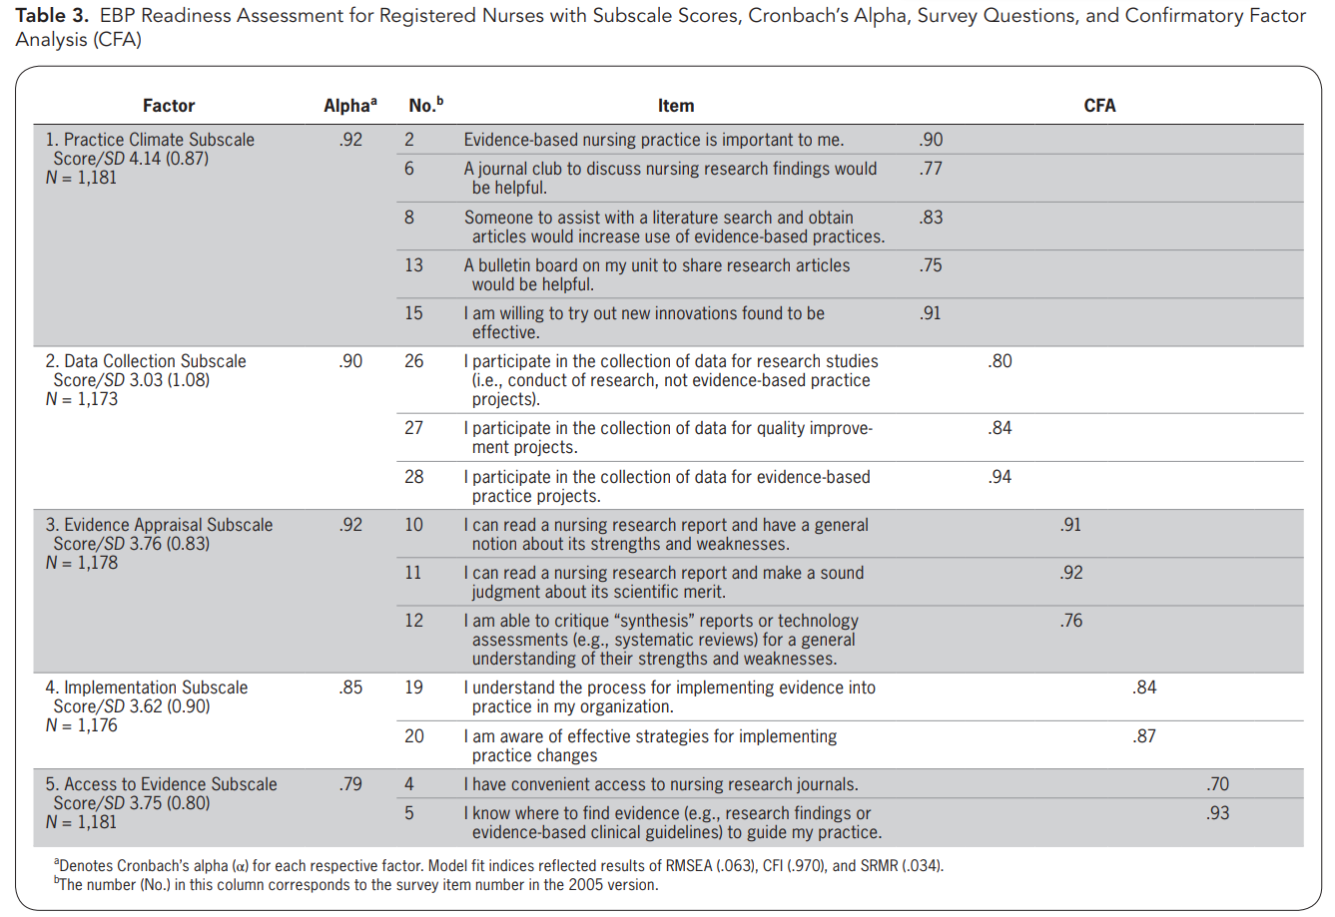
Example: Factor Analysis
These values are factor loadings, the stronger the value, the stronger the correlation with each factor it is linked to.
CFA is a form of “Validity”

Slide 13
Summary
Measurement and Assessment is a helpful approach in determining the reliability and validity of important things we examine.
Some of the Measurement methods we use are scales, principal components analysis, and factor analysis.
Factors allow us to safely collapse multiple items, improving the power of our analysis.
Measurement methods tend to happen with only predictors, however, our factors may be outcomes on their own.

Slide 14
Knowledge check
Which of the below are measurement and assessment methods?
Cronbach’s Alpha
Principal Components Analysis
Factor Analysis
Hierarchical Cluster Analysis
All of the above
2) Select the correct answer(s). What are the uses of measurement methods? (Select all that apply)
To develop measures of behaviors and beliefs.
To combine multiple variables that tap into the same dimension, improving statistical power.
To create achievement tests.

Slide 15
Knowledge check --
Answers
Which of the below are measurement and assessment methods?
Cronbach’s Alpha
Principal Components Analysis
Factor Analysis
Hierarchical Cluster Analysis
All of the above
2) Select the correct answer(s). What are the uses of measurement methods? (Select all that apply)
To develop measures of behaviors and beliefs.
To combine multiple variables that tap into the same dimension, improving statistical power.
To create achievement tests.

Slide 16
Appendix A
How to do a 1) Hierarchical Cluster Analysis, 2) Dendrogram, 3) Cronbach’s alpha, and 4) Factor Analysis in SPSS

Slide 17
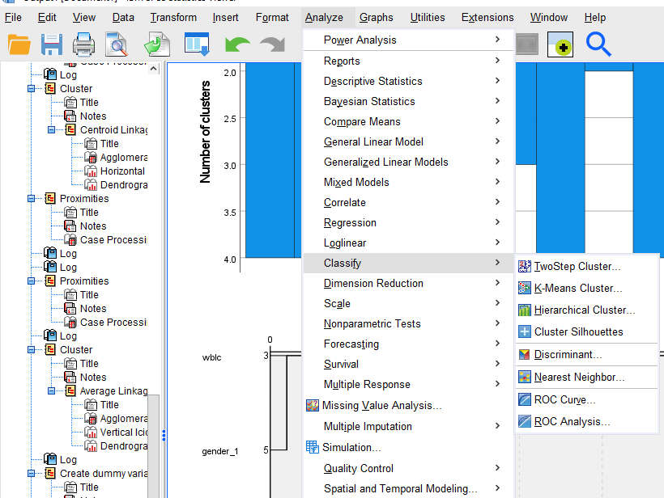
Hierarchical Cluster Analysis

Slide 18
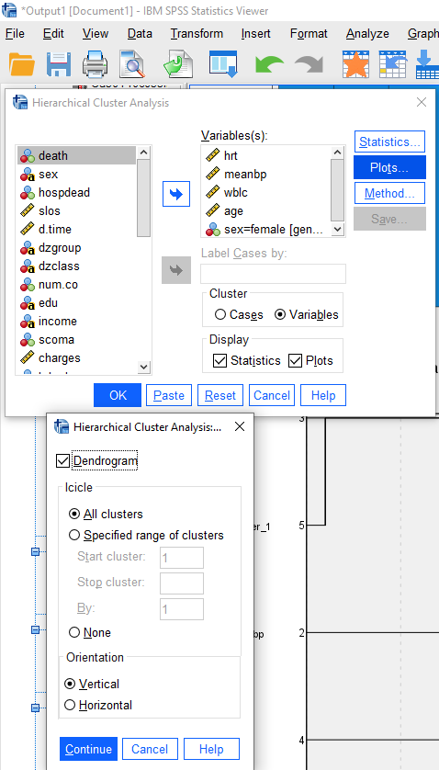
Hierarchical Cluster Analysis
with a Dendrogram
v

Slide 19
Dendrogram

Slide 20
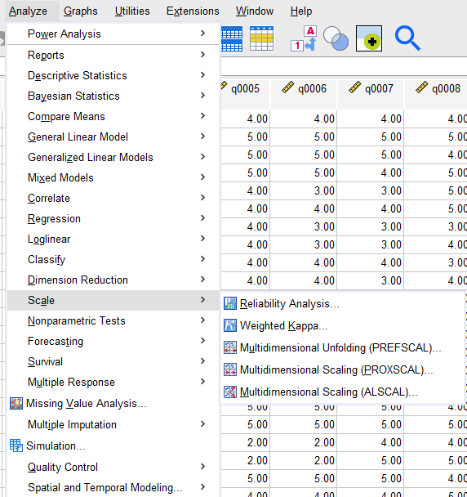
Cronbach’s Alpha

Slide 21
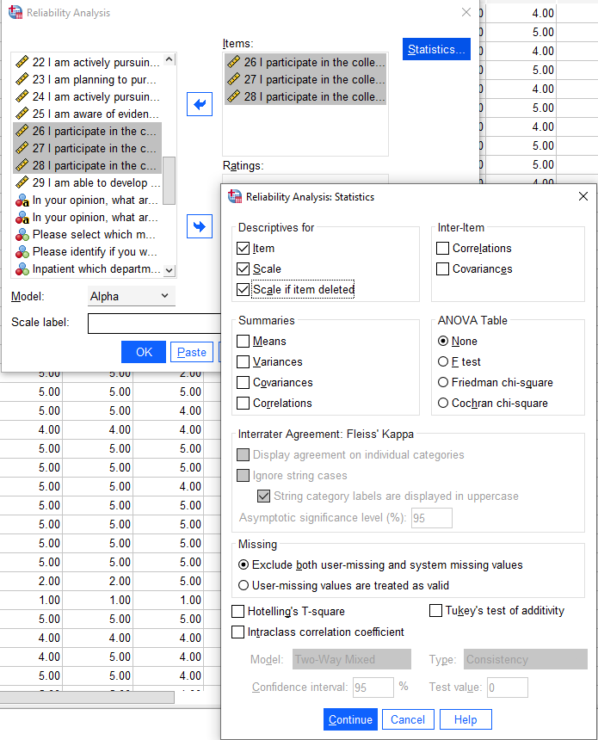
Cronbach’s Alpha

Slide 22
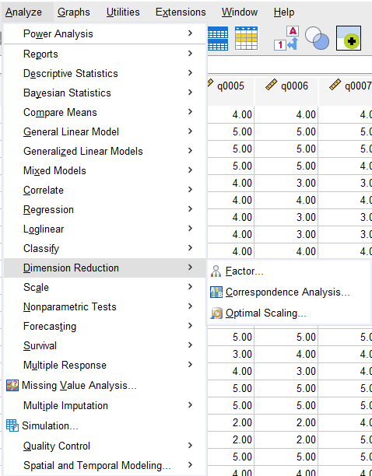
Factor Analysis

Slide 23
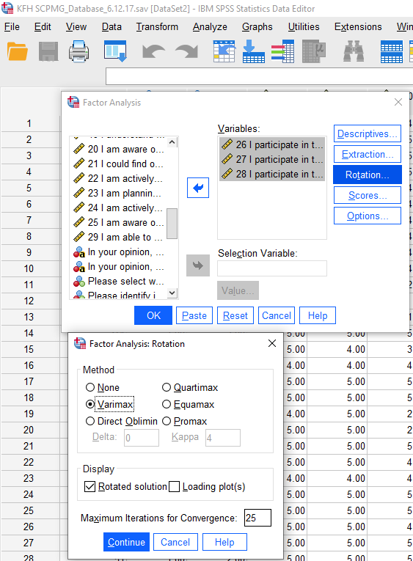
Factor Analysis

Slide 24
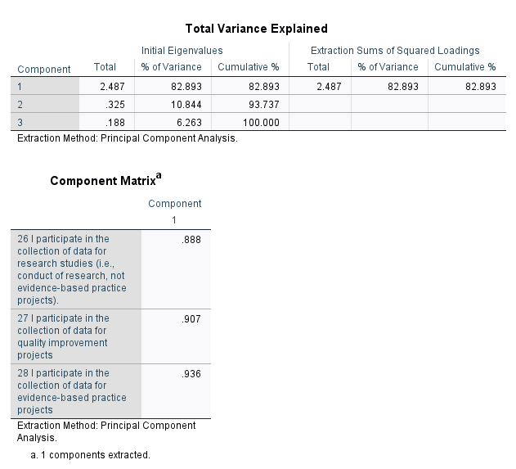
Factor Analysis

Slide 25
References
Crawford, C., Rondinelli, J., Zuniga, S., Valdez, R., Cullen, L., Hanrahan, K., & Titler, M. (2020). “Testing of the Nursing Evidence-Based Practice Survey”. Worldviews on Evidence-Based Nursing, 118-128.

