Slide 1
Research and Statistics
Session 6: Power analysis (t-test, chi-square)

Slide 2
Power Analysis
In this session, we’ll cover power analysis.
We can answer, “How big of a sample do I need?” or “How much power is in my study?”

Slide 3

What is a power analysis?
A power analysis is a way to calculate the sample size needed to achieve a desired probability that allows us to reject a null hypothesis, if the alternative hypothesis is true. We use the effect size, power level, alpha level, and statistical test to calculate the result.
A power analysis is also a way to calculate the level of power we have based on our effect size, sample size, alpha level, and statistical test.
For example, we conduct an experiment and find that Treatment B is better than Treatment A and has a power level of 0.80. If we conduct the same experiment 100 times, we expect to see significant results in about 80 of the 100 trials.

Slide 4
Key concepts
Power: Goal may be to have 80% power in the analysis given our sample size, alpha level, and expected effect size.
Effect size: Standardized differences (e.g., Treatment A – Treatment B)
Alpha level: This is the probability that a researcher expects in making a Type I error. The standard level is 0.05, hence p < 0.05.
Sample size: Goal may be to have a large enough sample to achieve 80% power in the analysis given our alpha level and expected effect size .
If we know 3 of the 4 values above, we can figure out the 4th value:
Power <- Effect size, Alpha, Sample Size
Sample Size <- Effect size, Alpha, Power

Slide 5
Types of power analysis tests
One-sample proportion tests
Two-sample t-tests
Correlations
R2
One- or two-tail tests
Regression coefficients
Many others inferential statistics

Slide 6
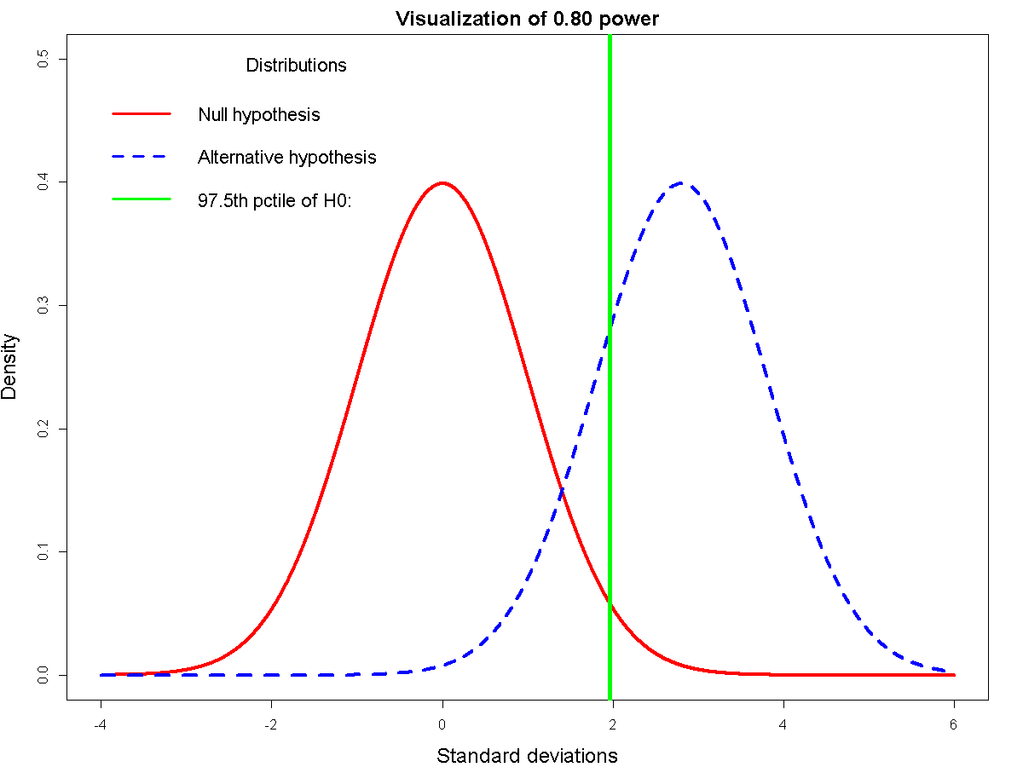
The green line indicates where 80% of the alternative hypothesis results exceed an alpha level of 0.05 (97.5th percentile).
This is 0.80 power

Slide 7
Strategies for increasing power
Sample size
Add subjects.
Assign more subject to groups which are cheaper to run.
Significance level
Choose a less stringent alpha (or significance) level.
Effect size
Increase the size of the hypothesized effect size.
Employ as few groups as possible.
Hypothesize main effects rather than interactions.
Employee measures which are sensitive to change.

Slide 8
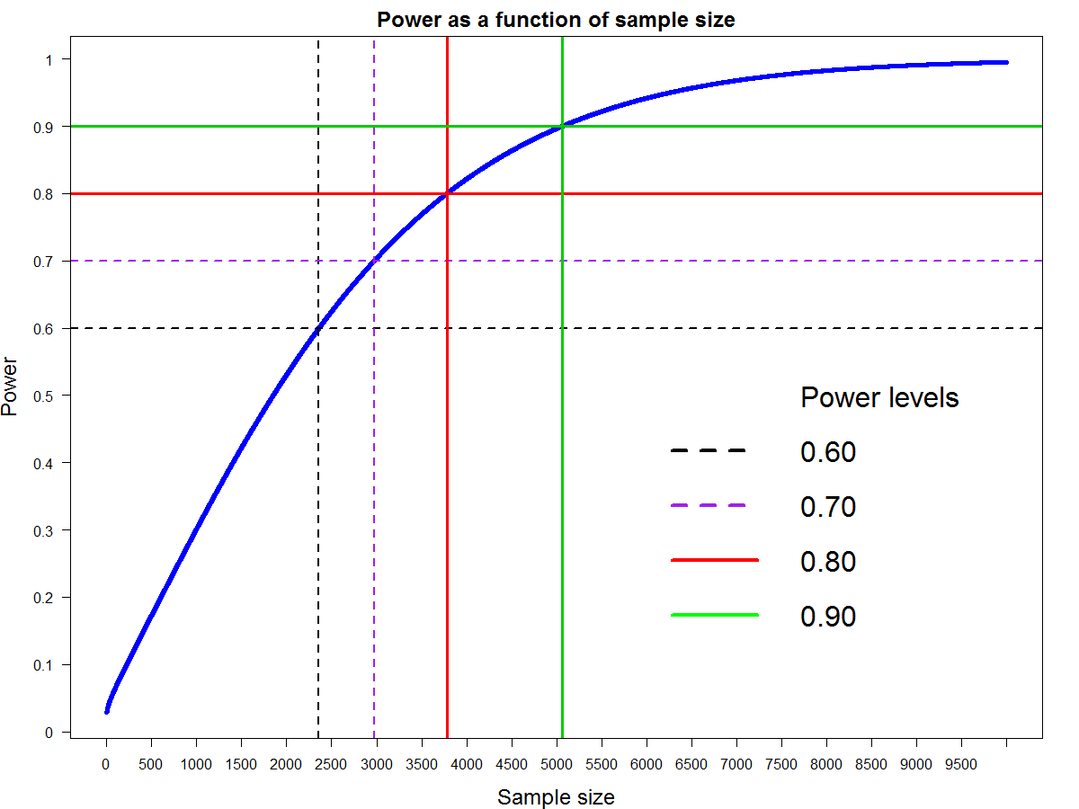
Achieving power beyond 0.90 would require very high sample sizes in this example and all others. This is costly.

Slide 9
Example 1
Question: How big of a sample do we need?
Summary: We want to compare the proportions of smoking or non-smoking moms that have babies with low birthweights.
We believe the two groups will have rates of 0.25 and 0.41 for non-smokers and smokers.
Using a proportion test with an alpha level=0.05, power level=0.80, and the above effect size, we need samples of 135 per each group.

Slide 10
Example 2
Question: How much power do we have?
Summary: We want to compare the proportions of smoking or non-smoking moms that have babies with low birthweights.
We expect to collect data from 115 non-smokers and 74 smokers.
Using a proportion test with an alpha level=0.05 and an effect size for rates of 0.25 vs. 0.41, we would have a power level=0.64.
Caution should be taken in post-hoc power calculations, there is more power when we calculate power before the study rather than after the study.

Slide 11
Summary
A power analysis can be performed on many types of studies with various types of research questions and research designs.
Alpha, power, effect size, and sample size are directly related. Changing any of those values impacts the other values.
Most researchers aim for a power of .80 to .90. Although, it may be tempting to reach for a power of 1, it will be costly. But oversample if you’ll lose subjects.
The effect size should be determined by one of three sources of information: 1) a literature review, 2) results obtained from a pilot study, and 3) ask an expert.

Slide 12
Knowledge check
Select the best answer(s) for what are the values used in conducting a power analysis?
Alpha level
Effect size
Power level
Sample size
All of the above
2) Select the best answer. What are the reasons for doing a power analysis?
To calculate the alpha level and effect size of my study.
To answer a question that I know I will get asked later.
To determine the sample size needed or the level of power I should expect in my study.

Slide 13
Knowledge check --
Answers
Select the best answer(s) for what are the values used in conducting a power analysis?
Alpha level
Effect size
Power level
Sample size
All of the above
2) Select the best answer. What are the reasons for doing a power analysis?
To calculate the alpha level and effect size of my study.
To answer a question that I know I will get asked later.
To determine the sample size needed or the level of power I should expect in my study.

Slide 14
Appendix A
How to do a power analysis for proportions in SPSS 27 using low birthweight and mother’s smoking data (N = 189, data in lbw.sav). And references.

Slide 15
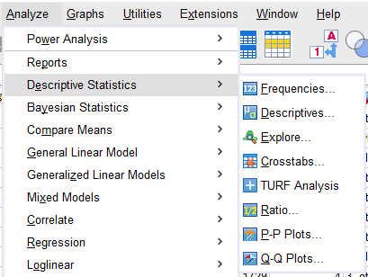
1. Calculate crosstabs to get proportions

Slide 16
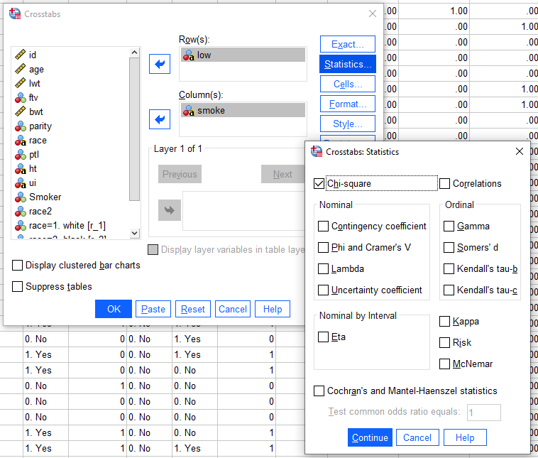
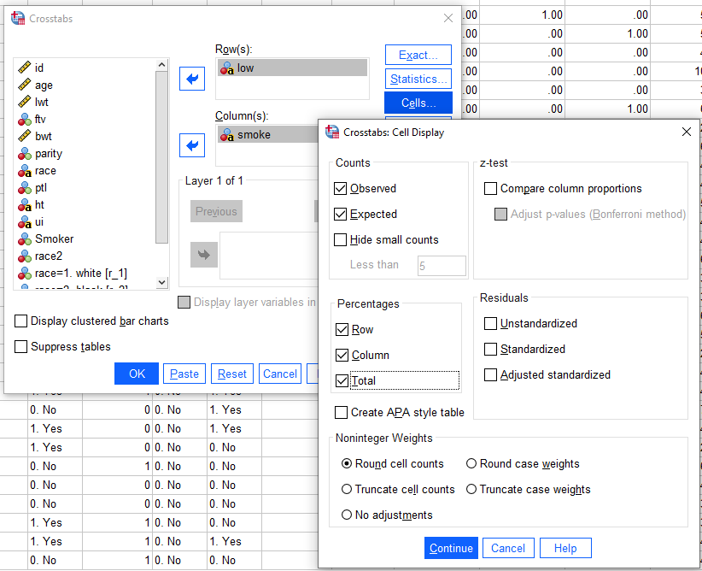
2. Select tests and cell statistics

Slide 17
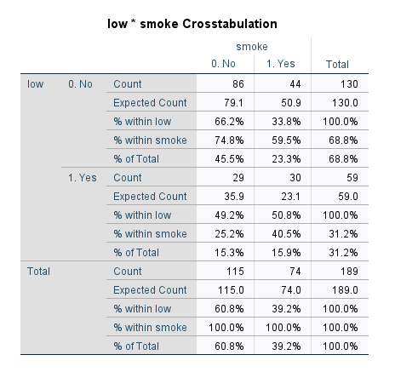
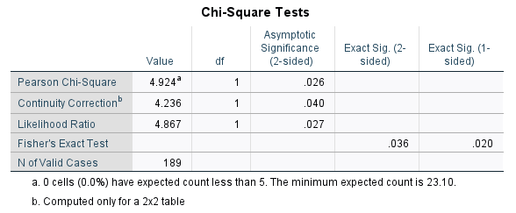
3. Identify the proportions of (non-)smokers who had babies with low birthweights
25% of non-smokers had babies with low birth weights compared to 41% of smokers. All 3 tests above are significant but just barely.

Slide 18
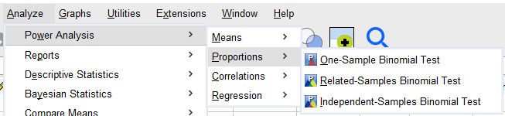
4. Select a power analysis for independent proportions (i.e., all moms are unique cases)

Slide 19
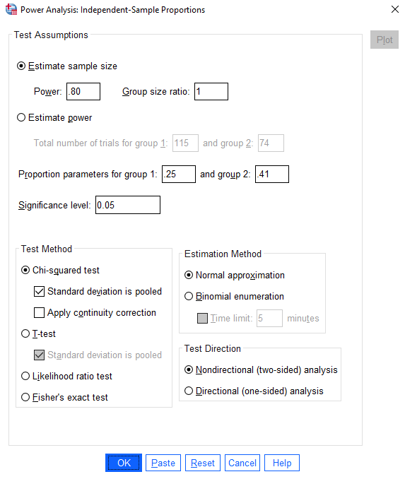
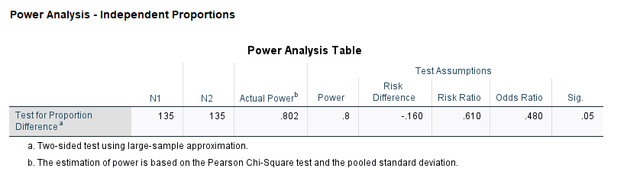
5. Conduct a power analysis to determine the sample size needed for 0.80 power
To achieve 0.80 power with the same results, we would need 135 subjects in each of the 2 groups.

Slide 20
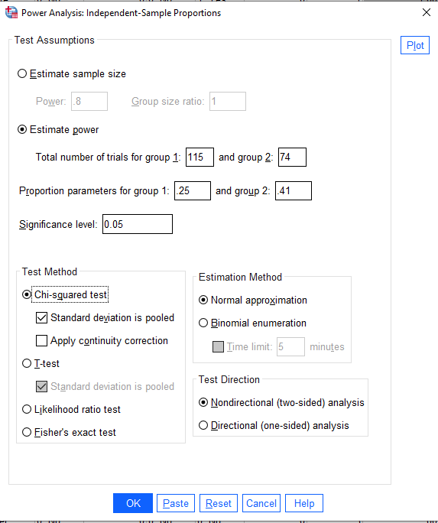
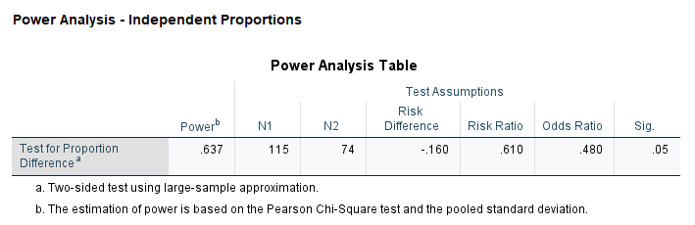
5. Conduct a power analysis to determine the power level (caution in post-hoc analyses)
Our level of power is 0.64. In other words, we expect to see significant differences repeated in about 64 of 100 future trials.

Slide 21
References
Bausell, R. (2002). Power analysis for experimental research. Cambridge, England: Cambridge University Press.
Cohen, J. (1988). Statistical power analysis for the behavioral sciences. New York, NY: Taylor & Francis Group.
Cumming, Geoff. (2012). Understanding the new statistics. New York, NY: Taylor & Francis Group.

