Slide 1
Research and Statistics
Session 5: Inference--Hypothesis testing using distribution tests (t-test, chi-square, ANOVA)

Slide 2
Distribution tests
In this session, we’ll review hypothesis testing and distribution tests.
And we’ll answer the question: “How do I interpret my results?”

Slide 3
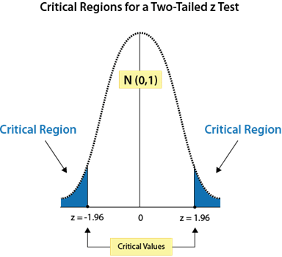
Confidence intervals and significance tests
Red circles represent the mean values from infinite samples. This forms the sampling distribution.
The white region between the blue is 95% of the graph area. This is the 95% Confidence interval.
The blue shaded region sums up to 5% of the graph area. This is the “p < 0.05” in statistical tests.
For example, if our study’s rare group difference falls into the blue region, that indicates there is at most a 5% chance of being wrong when we say there is a significant difference. What determines “rare” is how far it is from 2 SEs around the mean.
A significance test and 95% confidence intervals are reciprocals of each other. Once you know one value, you know the other. 95% CIs offer more useful info.
p < 0.05
p < 0.01
p < 0.001

Slide 4

Example
t-test and ANOVA on passenger ages of the Titanic
Hint: Important factors of surviving the Titanic are shown above.

Slide 5
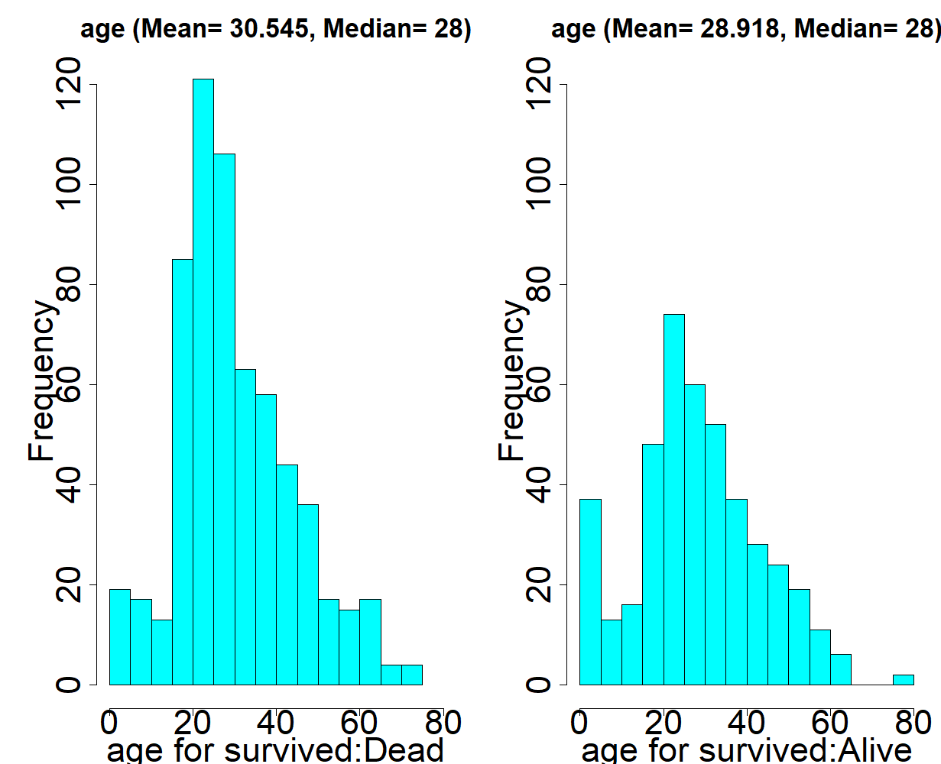
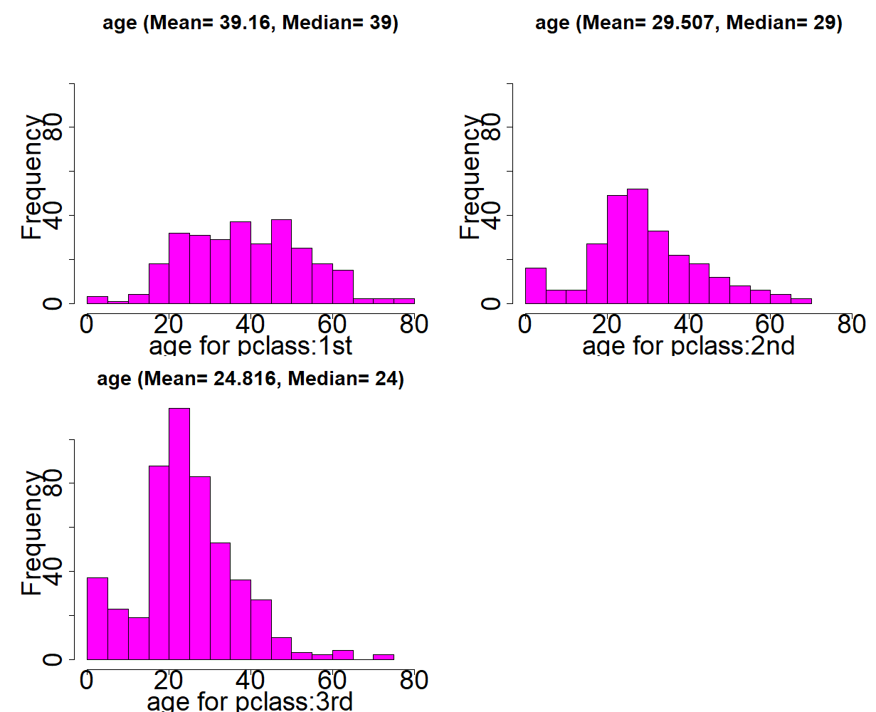
Age distributions of Titanic survival and passenger class. (Which looks significantly different?)
Survived the Titanic
Passenger class
Distribution tests take into consideration the mean and SD. Do the center and spread indicate important differences?

Slide 6
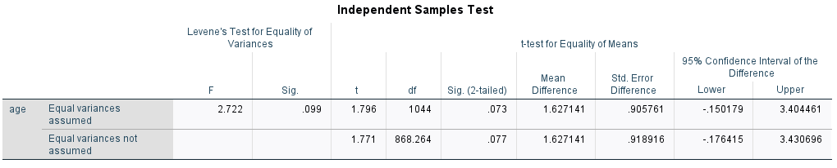
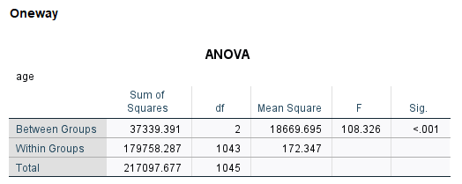
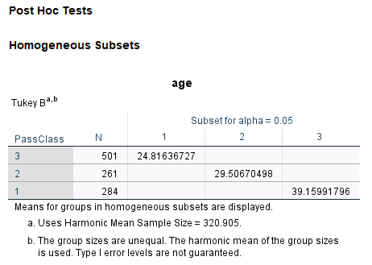
These Age results are only “marginally significant” (p < 0.10). We can see the t-statistic is not within the critical region that indicates significance at the p<0.05 level so we fail to reject the null hypothesis. We also see in the 95% CI that 0 falls within the range, therefore the results are not significant.
We don’t pick the direction in the difference, so we use the 2-tailed significance test. We can ½ the p-value to get the 1-tailed results.
Factor = Survived
We use independent sample t-tests instead of paired tests because paired tests are for dependent samples such as 2 measurements on the same person (Time 1 and Time 2).
Factor = Passenger class
We see that the F-statistic with 2 & 1043 degrees of freedom show significant age differences. The Tukey’s-b post hoc test shows all groups are significantly different because each mean value falls in separate columns. Values in the same column aren’t significant.

Slide 7
Summary
Inferential statistics differs from descriptive statistics because we use our sample’s data to make an inference about the population.
Distribution tests take into consideration the center and spread of distribution of groups.
Statistical tests often use sampling distributions to determine if group differences happen more than just by chance (p < 0.05).
Statistical tests are the inverse of confidence intervals.

Slide 8
Knowledge check
True or false? t-tests use the mean and variation as part of the calculation of significance:
True
False
2) True or false? Distribution tests let us make an inference from our sample to the population from which sample comes from:
True
False

Slide 9
Knowledge check--
Answers
True or false? t-tests use the mean and variation as part of the calculation of significance:
True
False
2) True or false? Distribution tests let us make an inference from our sample to the population from which sample comes from:
True
False

Slide 10
Appendix A
Sampling distributions and SPSS examples of calculating confidence intervals.

Slide 11
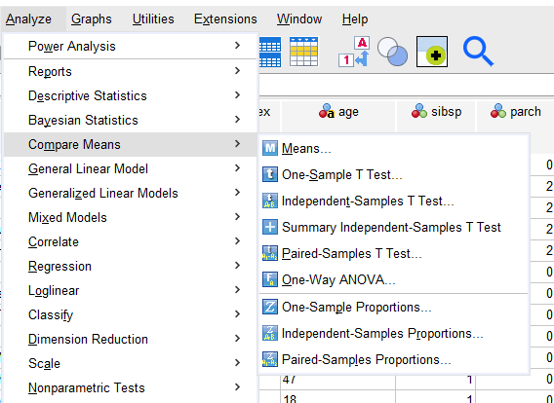
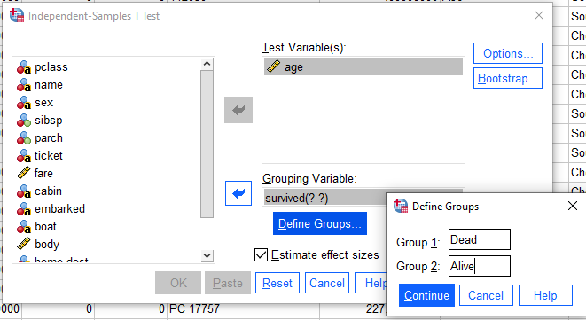
How to do a t-test in SPSS
Select “Independent Samples” and then enter variables and groups (when values are not numerical)

Slide 12
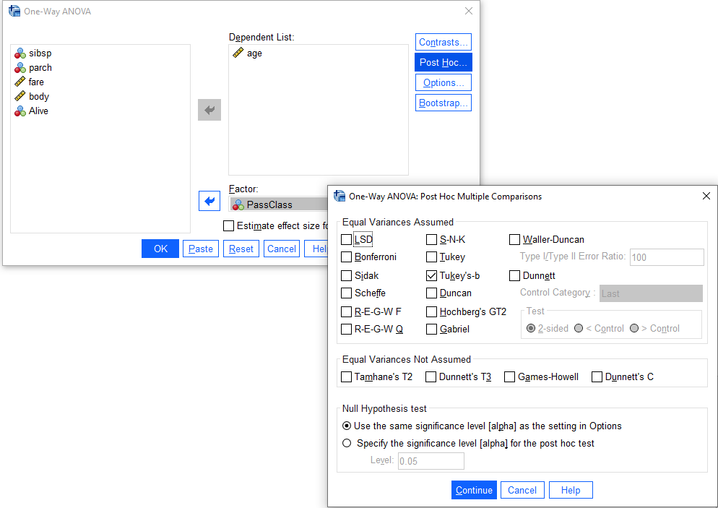
How to do an ANOVA in SPSS
Select “One-Way ANOVA” and then enter variables and groups. Select Tukey’s-b to get a post-hoc comparison between groups. All 3 passenger classes are significantly different from the others.

Slide 13
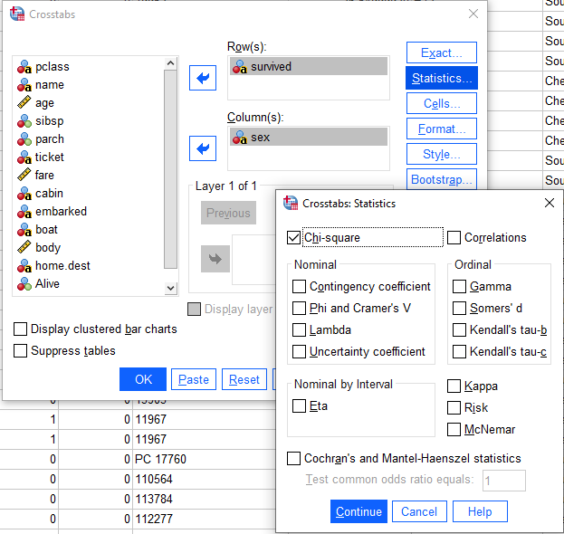
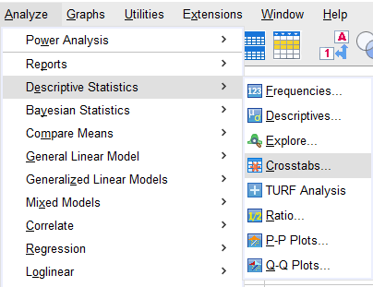
How to do a Chi-Square test in SPSS
Select “Crosstabs” and then enter variables and groups. Make sure to select the Chi-square option in the Statistics tab so you’ll get the Chi-square test results.

Slide 14
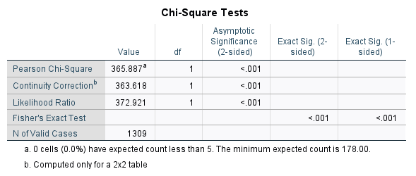
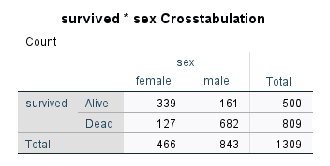
How to do a Chi-Square test in SPSS--Results
If 1 of the 4 cells had less than 5, an alternative test is the Fisher’s Exact test.
A Chi-square test the marginal values (values in the cross-tab margins) to see if they are proportionally distributed. If they are not, the result is “significant”. Above, we see women had a significantly higher distribution in terms of survival.

