Slide 1
Research and Statistics
Session 4: Inference--Confidence intervals and statistical significance

Slide 2
Confidence intervals and statistical significance
In this session, we’ll review confidence intervals, significance, and Type-I errors.
And we’ll answer the question: “What is statistical significance?”

Slide 3

Purpose of statistics
Description of the population or sample.
Inferences from the sample to the population.
Values that refer to the sample are called statistics.
Values that refer to the population are called parameters.

Slide 4
Different reasons for making inferences
Reasons
Examples
Generalize my sample results to the bigger population.
Check to see if 2 groups have significantly different rates.
The standard deviation (SD) of the age of the heart clinic patients I treat is 15 years. Therefore, about 95% of my sample (2 SDs) is aged 30 to 90.
Calculate the average LOS of patients in my hospital to estimate it for the entire multi-center system.
The intervention program reduced CHF deaths 20%. Is it significant?
We are 95% confident the average age of CA clinic patients is between 59 and 71. If we sample 100 groups of patients, we expect to see average ages of 59 - 71 in about 95 of the 100 groups.

Slide 5
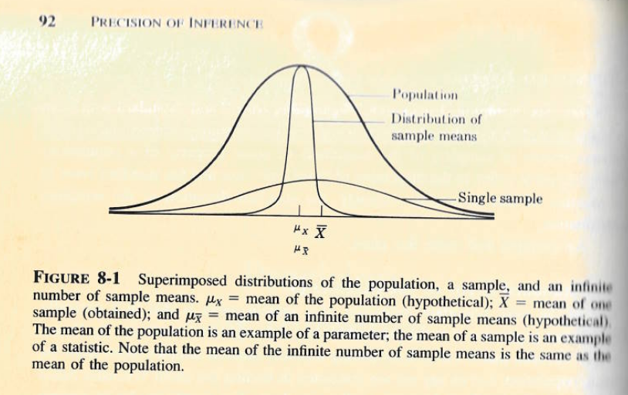
Different types of distributions
Though rarely known, we try to estimate the population distribution.
It is important to note that distributions of sample means represent many individuals (e.g., a value of 50 might represent the mean age of 100 patients).
We use formulas to calculate the distribution of sample means (i.e., we generally don’t use multiple samples).

Slide 6
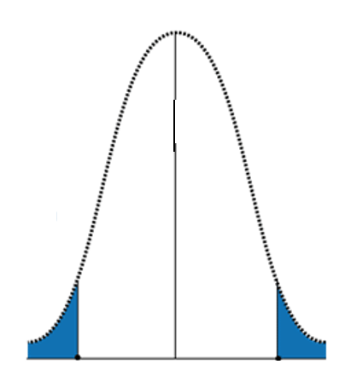
More on sampling distributions
Red circles represent the mean values from infinite samples. This forms the sampling distribution.
Red circles within the white area are in the normal range, this is 95% of the area. We have a 95% level of confidence that if we get another 100 samples, 95 would have a mean within that range
Remember the 68-95-99.7 rule when thinking of standard errors. The rule also applies to 1-2-3 standard errors. SEs are the SDs of sampling distributions.
95% is a common confidence interval but other routine values are 90% and 99%.
Although rare, some values fall into the “rejection region” of the null hypothesis. When that happens, we say it is “significant”.
We can have 95% CIs on any estimated value: means, differences, correlation coefficients, etc.
e.g., clinic mean= 65, SE=5.

Slide 7
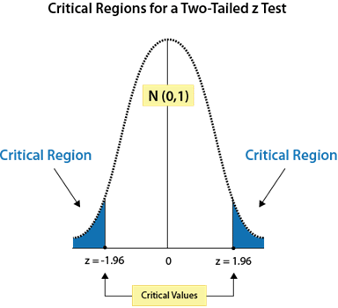
Confidence intervals and significance tests
The blue shaded region sums up to 5% of the graph area. This is the “p < 0.05” in statistical tests.
The white region between the blue is 95% of the graph area. This is the 95% Confidence interval.
For example, if our study’s rare group difference falls into the blue region, that indicates there is at most a 5% chance of being wrong when we say there is a significant difference. What determines “rare” is how far it is from 2 SEs around the mean.
A significance test and 95% confidence intervals are reciprocals of each other. Once you know one value, you know the other. 95% CIs offer more useful info.
p < 0.05
p < 0.01
p < 0.001

Slide 8
Example
95% Confidence intervals of Titanic survival, inpatient bed utilization, and Tableau

Slide 9
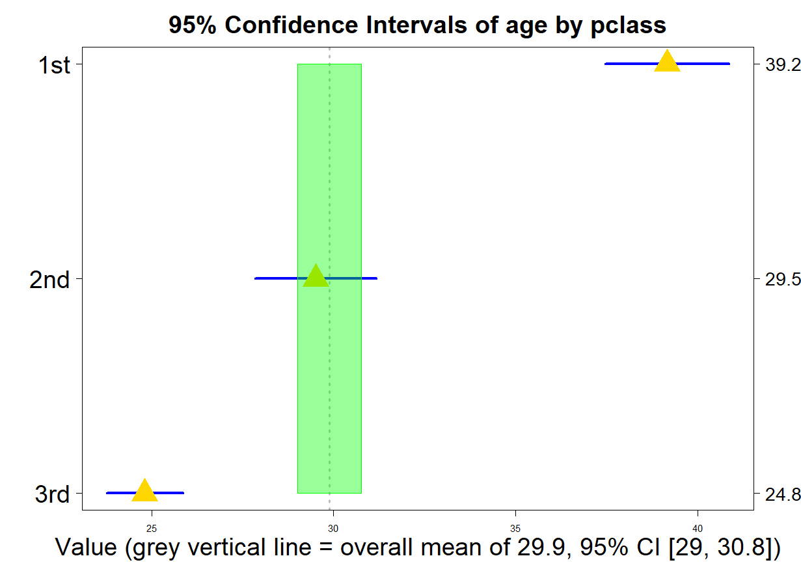
(passenger class)
95% CI formula= mean +/- 1.96 * SE
1.96 * SE = “Margin or Error”
Standard Error = Std. Dev./ SQRT(N)
This formula is similar for various types of outcomes
To interpret the results, any gold triangles (means) that do not fall within the blue bar (95% CIs) of a different passenger class are significantly different.
For example, 1st and 2nd classes are different because the gold triangle of 2nd class doesn’t lie within the blue bar of 1st class. And vice-versa.
As samples get bigger, confidence intervals get smaller (see SE). With more data, we have less “uncertainty”. Notice the width of the green band for everyone is narrower than the blue bars for each passenger class.
The CI is the mean +/- the “margin of error”

Slide 10
Type-I errors and statistical significance
Type-I error: Incorrectly stating the Null Hypothesis is false when it is true.
Statistical significance: Meeting an acceptable probability of a Type I error given a specified alpha level (e.g., < 0.05).
In other words, it is the probability of us being wrong that we have an important result.
Significance tests can indicate if we have achieved an acceptable level for the chance of a Type-I error.
Confidence intervals provide info on a normal range. We don’t need to conduct significance tests once we have confidence intervals. For example, if a lab value is outside the 95% CI, it is significantly different.

Slide 11
Summary
Inferential statistics differs from descriptive statistics because we use our sample’s data to make an inference about the population.
Confidence intervals provide a level of confidence in what we measure (e.g., means, group differences, correlations, etc.).
With a larger sample, we have more certainty and therefore our confidence intervals become narrower.
Be cautious with big data because null hypothesis testing will always give 100% false alarms with “infinite patience” (Kruschke, 2015). In other words, everything will look significant with enough data.

Slide 12
Knowledge check

Slide 13
Knowledge check-- Answers

Slide 14
Appendix A
Sampling distributions and SPSS examples of calculating confidence intervals.

Slide 15
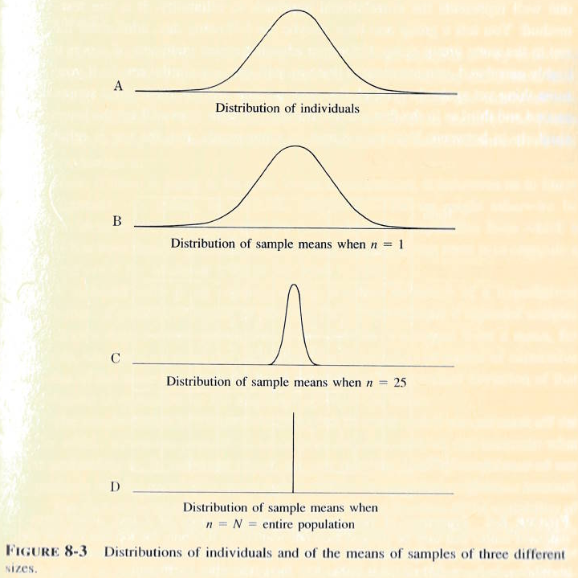
Sampling distributions get smaller when sample sizes get bigger
It’s important to note that as the number of sample means gets bigger, the distribution get narrower.
Big data can make minor things look significant because sample size is part of the formula. Be careful in interpreting results.

Slide 16
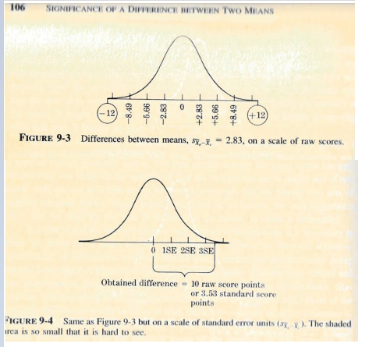
Sampling distributions on group differences
We want to test if our group difference is significantly different from 0 (0= no difference). When a test statistic exceeds the critical value (positive or negative), we have significant results.
We can have sampling distributions on differences in average values between 2 groups.
Group 1 – Group 2 = 10.
The difference between Group A and Group B is 10 points.
The Standard Error= 2.83
Test statistic= 10/ 2.83= 3.53
Surpassed the critical value of 1.96, have significant results.
When we examine group differences, correlation or regression coefficients, etc., we assume the mean is 0 with negative to positive values.

Slide 17
Glossary
*Sampling distribution: A distribution of statistics from the sample. For example, a sampling distribution may have the means from many samples on age, group mean differences, correlation coefficients, etc. The sampling distribution is a fundamental part of most statistical (parametric) tests. Non-parametric tests have fewer assumptions but use similar concepts.
Sampling error: The dispersion (spread) of the sampling distribution.
Standard error of the mean: The standard deviation of the sampling error. A small standard error tells us that the sample statistic is a reliable estimate of the corresponding population mean because the parameter is always close to the sample statistics by default.
Confidence interval: A range of the sampling distribution that a population parameter falls within, given a specified confidence level (e.g., 95%) .

Slide 18
Inferences
We estimate population parameters from our sample statistics.
Estimating the parameter is complex because it is rarely known so we measures it with a level of confidence (e.g., 95%).
These values are commonly referred to as a point estimate (mean or average) and confidence intervals (e.g., 95% confidence interval).
We use 95% because the tails can go to infinity. Intervals of 100 to 200 vs. 0 to 10,000. Intervals need to be helpful, 100% CIs are not.
The inverse of a confidence intervals is the p-value. For example, if we know the 95% confidence interval for LOS is 2 to 7 days but a competing medical system has a mean LOS of 12 days, we would know the difference between us and them is at least significant at p < 0.05 level. No math is needed when you know the 95% CI (or graph it).

Slide 19
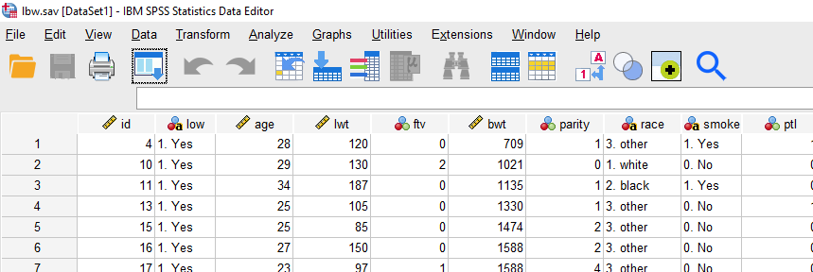
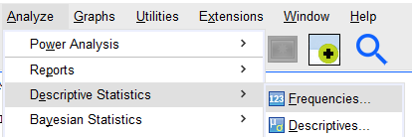
95% Confidence Interval: Birthweight

Slide 20
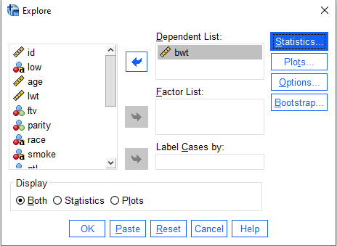
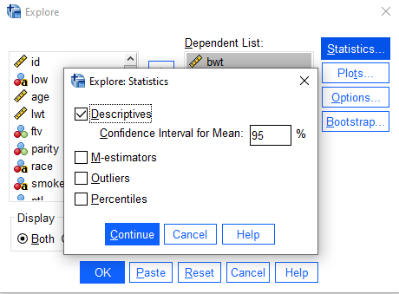
95% Confidence Interval: Birthweight
Click on “Statistics” to specify the confidence level or accept the default 95%.

Slide 21
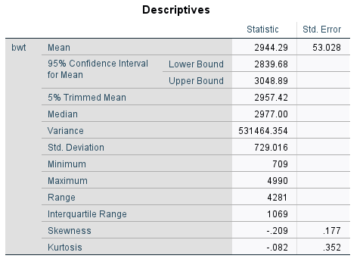
95% Confidence Interval: Birthweight

