Slide 1
Research and Statistics
Session 3: Relationships in the data -- Correlations and scatterplots

Slide 2
Correlations and Scatterplots
In this session, we’ll review correlations, scatterplots, and proportion of variance explained.
And we’ll answer the question: “What do I do when my trend is not significant?”

Slide 3
Different reasons for using correlations
Reasons
Examples
Check to see if 2 variables are related.
Check to see if there is a trend in data.
Reliability of one variable as a measure of another variable.
Make predictions.
Create composite variables when R is high (>= 0.95) or suitable.
Correlate yearly 30-day mortality and 30-day readmission rates.
Correlate months (e.g., 1-36) and LOS to see if we improved.
Correlate gold standard med device with a cheaper option.
Correlate age and LOS .
The average of 2 survival scores or mean blood pressure.

Slide 4
Correlations
The correlation coefficient (R) ranges from -1 to 1. Negative and positive correlations. R=0 indicates no correlation.
The following rules apply to positive correlation values but have the same meaning for negative correlations. General guidelines in the strength of correlations: 1) >= 0.70 is strong, 2) 0.30 – 0.70 is moderate, 3) < 0.30 is weak, 4) 0.0 = no correlation, 5) correlations of -1 or 1 are perfect correlations.
Causation vs. correlation vs. confounding: Causation indicates a cause-and-effect path. Cause and effects can be correlated but correlations are not necessarily cause-and-effects. Confounders can be a 3rd variable correlated with both independent and dependent variables that impact the relationship (e.g., motivation can confound the correlation between math ability and SAT math scores).

Slide 5
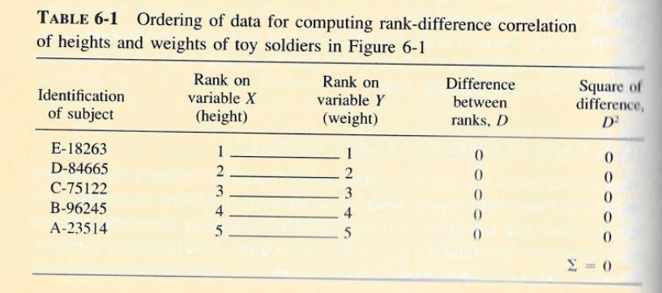
Positive correlation calculation
Notice the rank on X matches the rank in Y. As one values goes up, the other values goes up. This is a perfect positive correlation (R= 1.0).

Slide 6
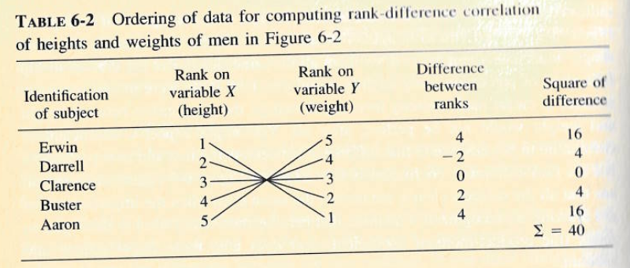
Negative correlation calculation
For perfect negative correlations, the rank on X matches is in the opposite rank in Y. As one values goes up, the other values goes down (R= -1.0).

Slide 7
Special considerations
Small sample statistic. Correlations are helpful with large and small samples. But we should be careful with aggregated data because the correlation coefficient can be higher than expected.
R^2 represents the amount of variance in Y (dependent variable) explained by X (independent variable). Knowing X gives us an idea of why we get different Y values. For example when R= -0.78, the R^2 is 0.60. The Pearson correlation gives the same R^2 that we get from a simple linear regression.
Pearson, Spearman, and Kendall tau correlations can handle continuous, ordinal, and binary data. Kendall works especially well in ordinal correlations, Spearman work well in skewed data. Pearson is fastest to calculate results. There are many more types of correlations.
Partial correlations control for other variables but we get more power in regression.

Slide 8
Examples
Scatterplots, correlation tests, correlation matrix, and nonlinear trends.
Hosmer & Lemeshow’s low birthweight study (N = 189). https://www.stata.com/manuals13/semexample33g.pdf
Nursing Research - SCAL-Quality Systems and Reporting - AKME Confluence (kp.org)

Slide 9
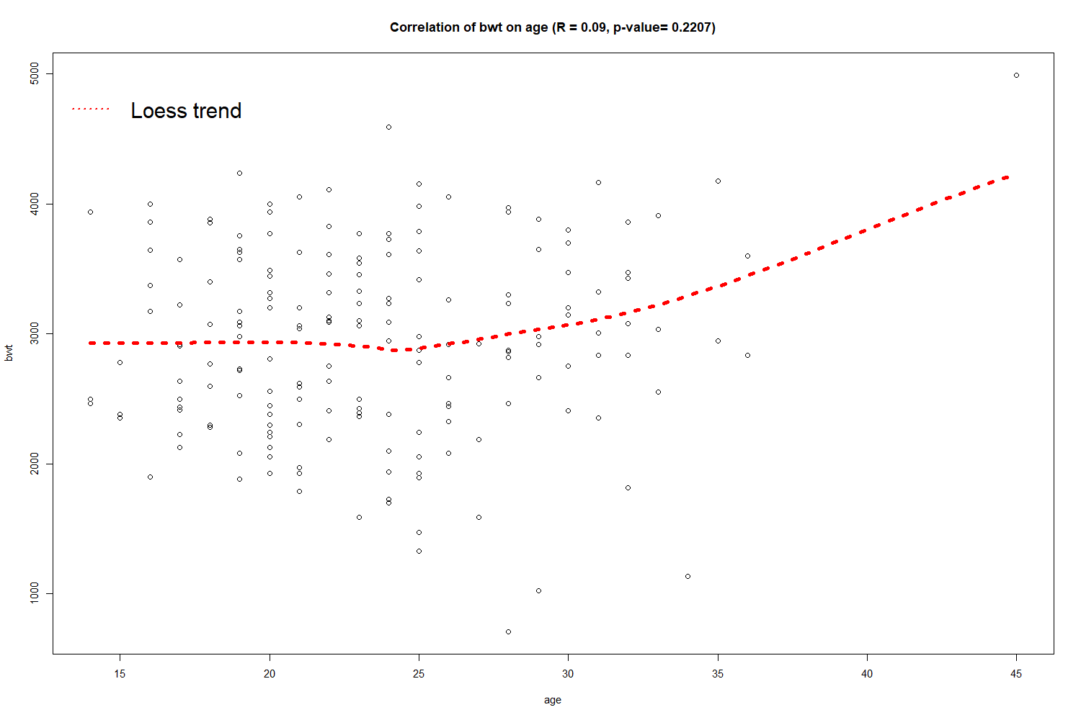
Scatterplot of age and birthweight
The R of 0.09 (p=0.22) may still be important or clinically relevant.
The red Loess trend line helps us see the nonlinear association between age and birthweight

Slide 10
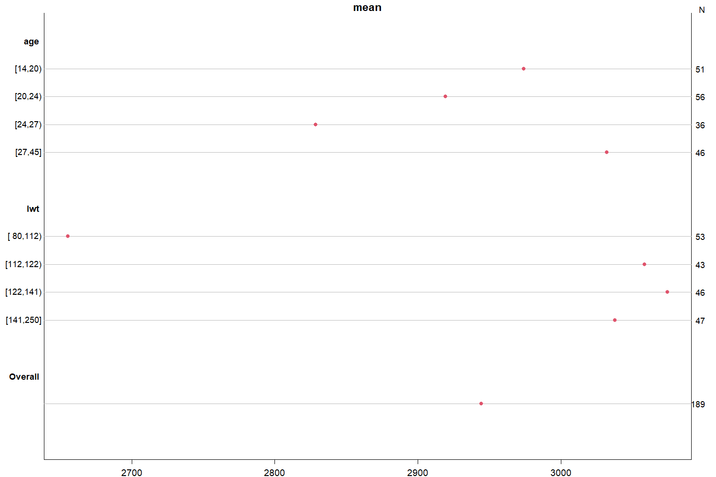
Age
An alternative approach to a scatterplot is to look at the mean birthweight by quartiles of age or mother’s last weight before pregnancy. This helps with very large datasets because scatterplots become less helpful in spotting trends. For example, the trend goes linearly downward as age goes up, except for the top ages.
Mom’s last weight

Slide 11
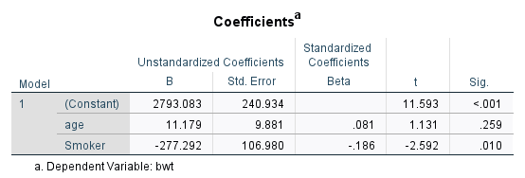
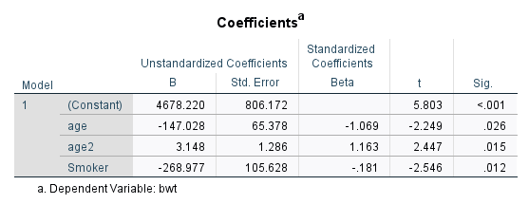
Compare results between models that treat age as a linear or nonlinear trend
Linear
Nonlinear
We square the age value to make a nonlinear term
We interpret this as “age decreases at an increasing rate”
R^2 =0.043
R^2 =0.073
“Not significant”
P < 0.05
Adjusting for the nonlinear association between birthweights and the mother’s age helps show the importance of age. Age should be included whenever it is considered clinically relevant by the researcher but using nonlinear terms as it appeared likely in the scatterplot can be helpful to explain the degree of association.

Slide 12
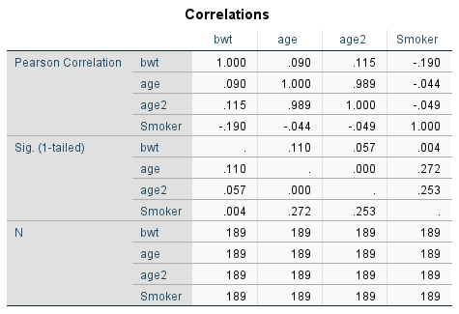
We can see the squared age variable is correlated more so than the actual value
The correlation matrix shows a higher R for age2. We should consider an interaction between being a smoker and age as an alternative analysis.

Slide 13
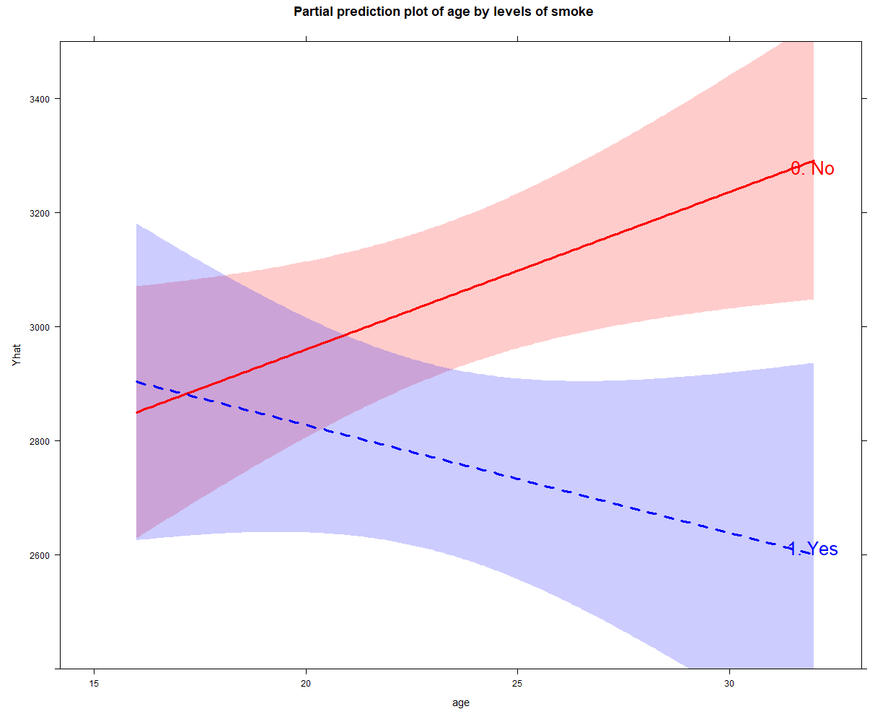
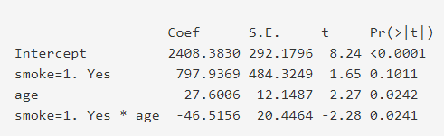
There is something going on with age and smoking
It appears the smoking effect is small between younger mothers. But birthweights significantly differ after age 25. In other words, mothers 25+ benefit by not smoking. This explains the upward trend in the scatterplot in the previous slides.
Important to note the high correlation between smoking and drinking and birthweight.

Slide 14

Summary
Scatterplots show linear and nonlinear trends between variables. We seldom see perfectly linear trends.
Correlations provide a measure of the relationship/association between variables (correlation coefficient R). The higher the value, the closer the data points fall along a trend line.
When faced with unexpected non-significant trends, we can use scatterplots and correlations to identify a nonlinear & significant trend between our predictors and outcomes.

Slide 15
Knowledge check
Which of the following reasons below do you not do correlations?
Check to see if two variables are related
Calculate group rate differences in the data
Reliability of one variable as a measure of another variable
Make predictions
Create composite variables when it is high (>=0.95) or suitable
A correlation of <.30 is considered:
Positive, low
Strong
Moderate
Weak
None of the above

Slide 16
Knowledge check-- Answers
Which of the following reasons below do you not do correlations?
Check to see if two variables are related
Calculate group rate differences in the data
Reliability of one variable as a measure of another variable
Make predictions
Create composite variables when it is high (>=0.95) or suitable
A correlation of <.30 is considered:
Positive, low
Strong
Moderate
Weak
None of the above

Slide 17
Appendix A
SPSS examples of a scatterplot on birthweight and age, relaxing the assumption of linearity in a linear (OLS) regression

Slide 18
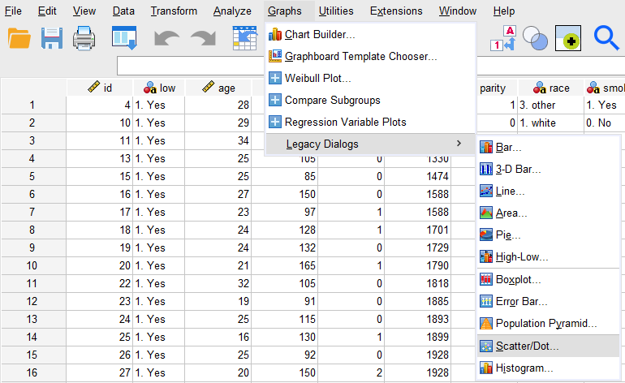
How to create a scatterplot

Slide 19
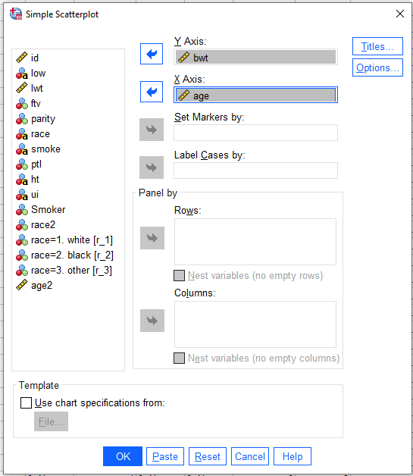
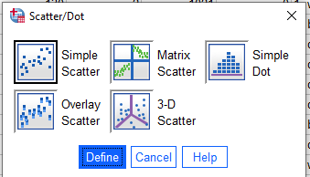
Select “Simple Scatterplot” and choose variables (y-axis traditionally is for outcomes)

Slide 20
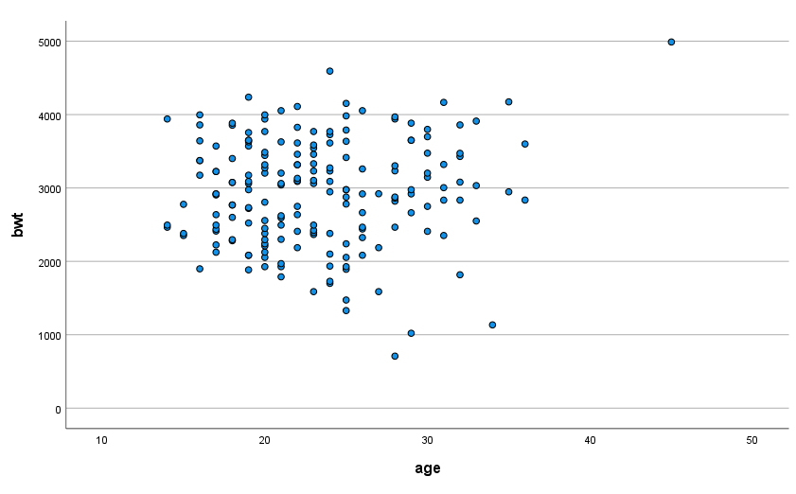
Scatterplot

Slide 21
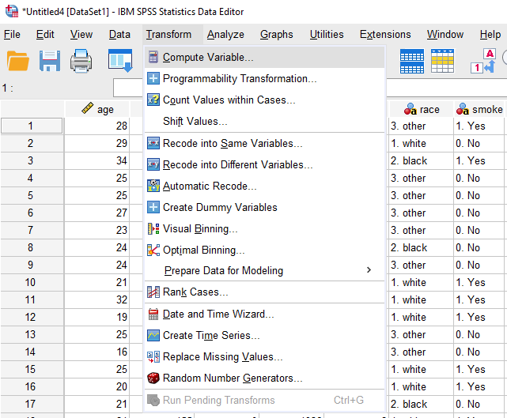
How to make a squared age variable to test nonlinearity

Slide 22
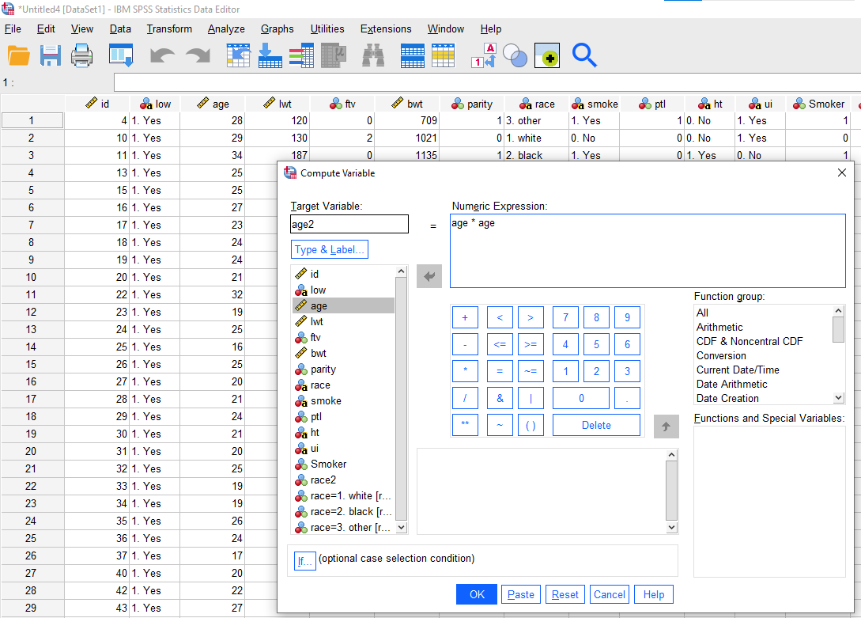
Multiply age * age to get squared values for the new variable “age2”.

Slide 23
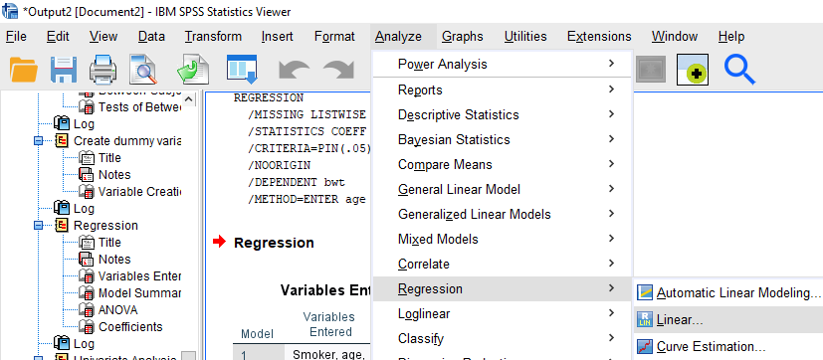
Run a linear regression to compare the statistical significance of age when allowing nonlinearity

Slide 24
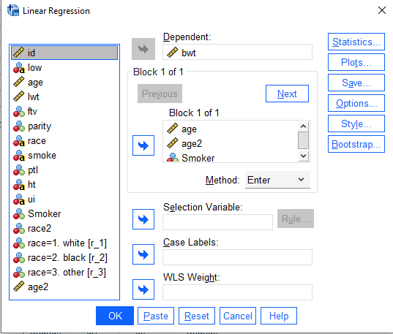
Set up the linear regression and run

