Slide 1
Research and Statistics
Session 2: Distributions -- Central tendency and variability

Slide 2
Distributions
In this session, we’ll review the center and spread of distributions.
And we’ll answer the question: “What do I do when my results are not significant?”

Slide 3
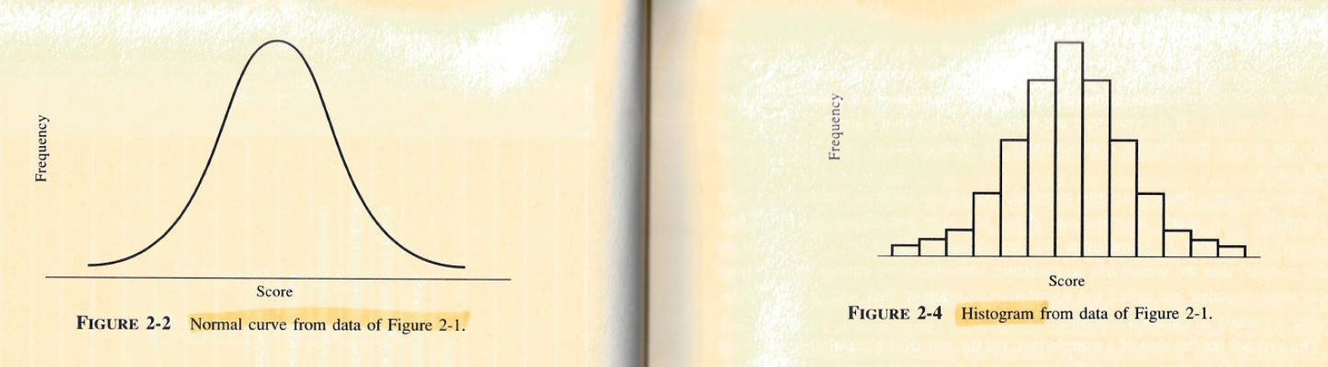
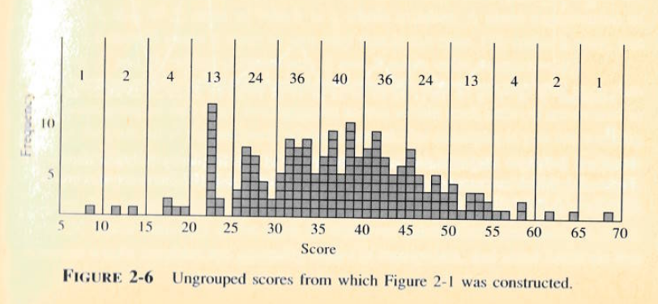
Normal distribution: Curve and histogram
Each bin contains the count of cases with that range of values. For example, 40 people had scores between 35 and 40.
From the book: “How to Think about Statistics”

Slide 4
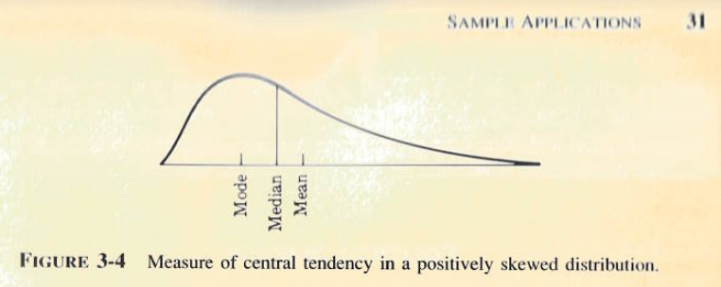
The center or “average”: Mean, median, mode
See the appendix for examples of skewness and kurtosis.

Slide 5

Measures of variability (Support data hospital stay charges $)
Mean: Arithmetic mean is $56,271
Standard deviation: Average squared deviation ($83,354) around the mean.
Percentiles: Percent of the distribution at which X percentile falls below that value. E.g., $26,499 is the 50th percentile (or median). 50% percent of patients have charges at or below $26,499.
IQR: The distance between the 25th to 75th percentiles (IQR= $56,271 – 10,029 = $46,242 for charges).
Range: The lowest and highest values (charges: $1,636 and $740,010).
5 number summary: The range and quartiles (25th, 50th, 75th percentiles). Here: $1,636, 10,029, 26,499, 63,622, 740,010.
Skewness: Non-symmetrical quality of distribution.
Kurtosis: How wide or narrow is a distribution.

Slide 6
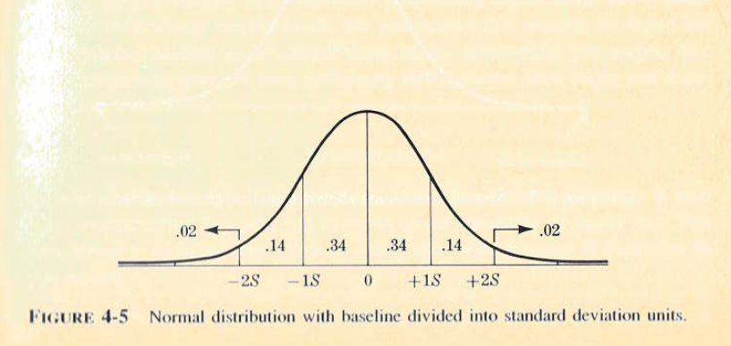
Proportion of data within 1 and 2 standard deviations of the mean.
68 - 95 - 99.7 rule for 1-2-3 SDs

Slide 7
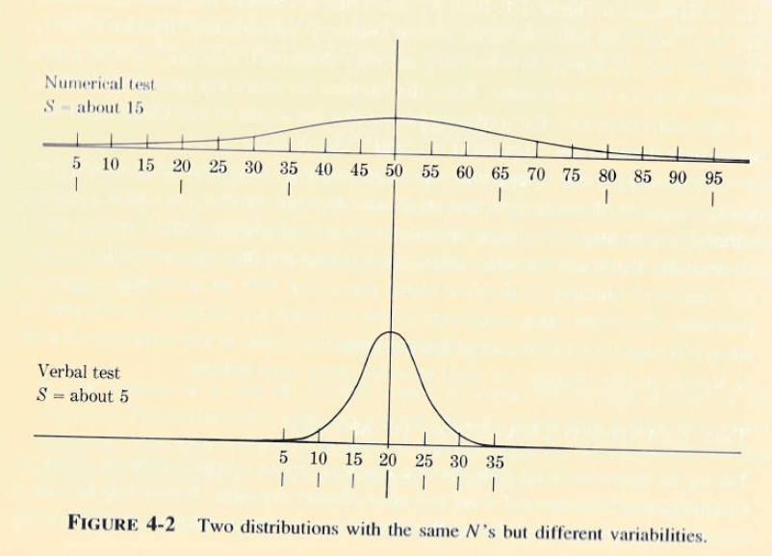
Data with the same mean but different variability don’t look the same
S = standard deviation

Slide 8
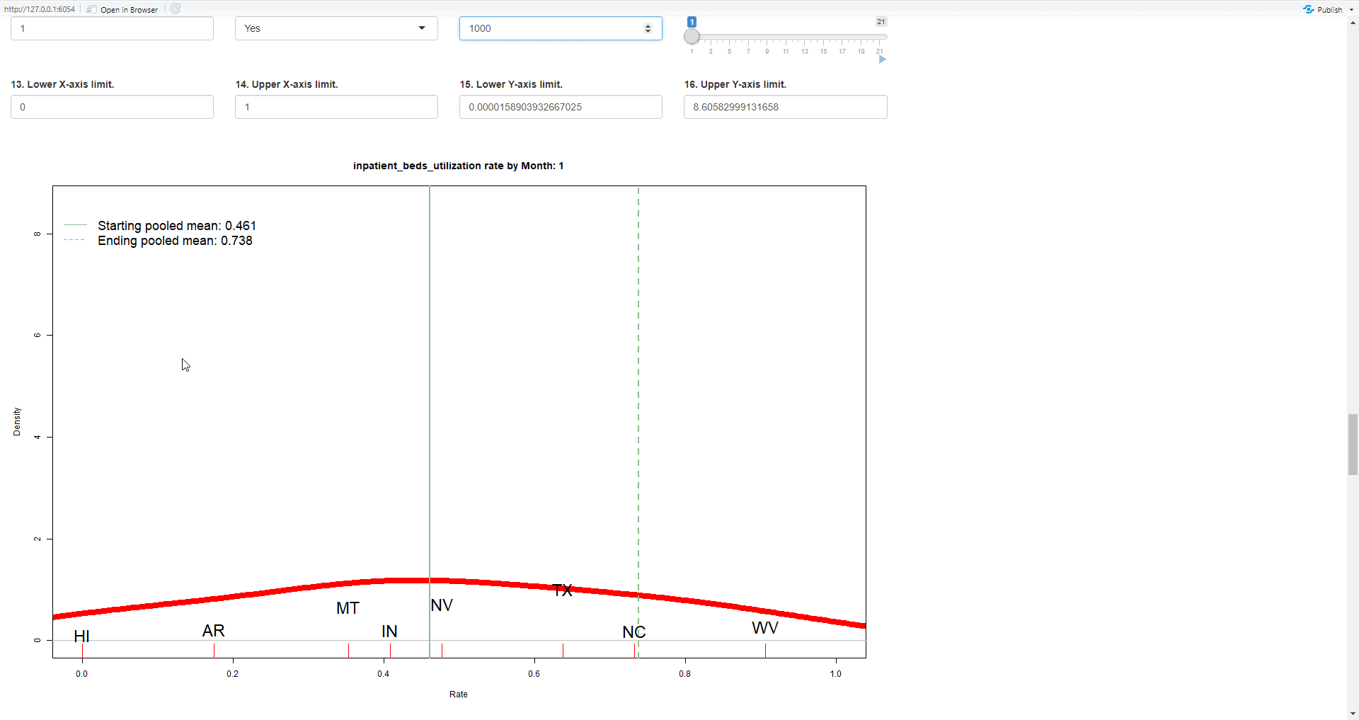
Change over time
In January 2020, beds were not over-utilized in the US.
As covid spread in the next 1 ½ years, bed use increased consistently across the country.

Slide 9
Special considerations
Non-normal distributions are common. We can still use the mean to estimate important values.
For example, length of stay values are often very skewed but stable. The mean might be 11 days and that value would be helpful for projecting staffing requirements, etc. But to describe the “average patient’s stay”, using the median of 2 days is more appropriate.
With skewed distributions, be careful about your interpretations with large standard deviations.

Slide 10
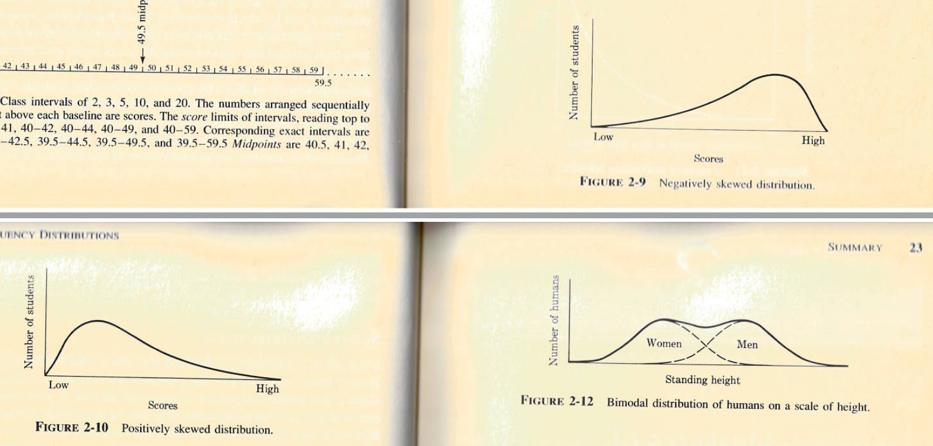
Examples of other distributions
Men and women may differ, we’ll want to examine this more. Data is a “mixture”.

Slide 11
Study to Understand Prognoses and Preferences for Outcomes and Risks of Treatments (SUPPORT)
Study to examine the outcomes of seriously ill hospitalized patients.
Data collected from 1991-1994. N= 9,105
An outcome and factor are cost & disease group (“charges” & “dzgroup”).
Study article (“Harrell, 1995, Support Prognostic Model”) and data found here: https://confluence.analytics.kp.org/confluence/display/SQS/Nursing+Research

Slide 12
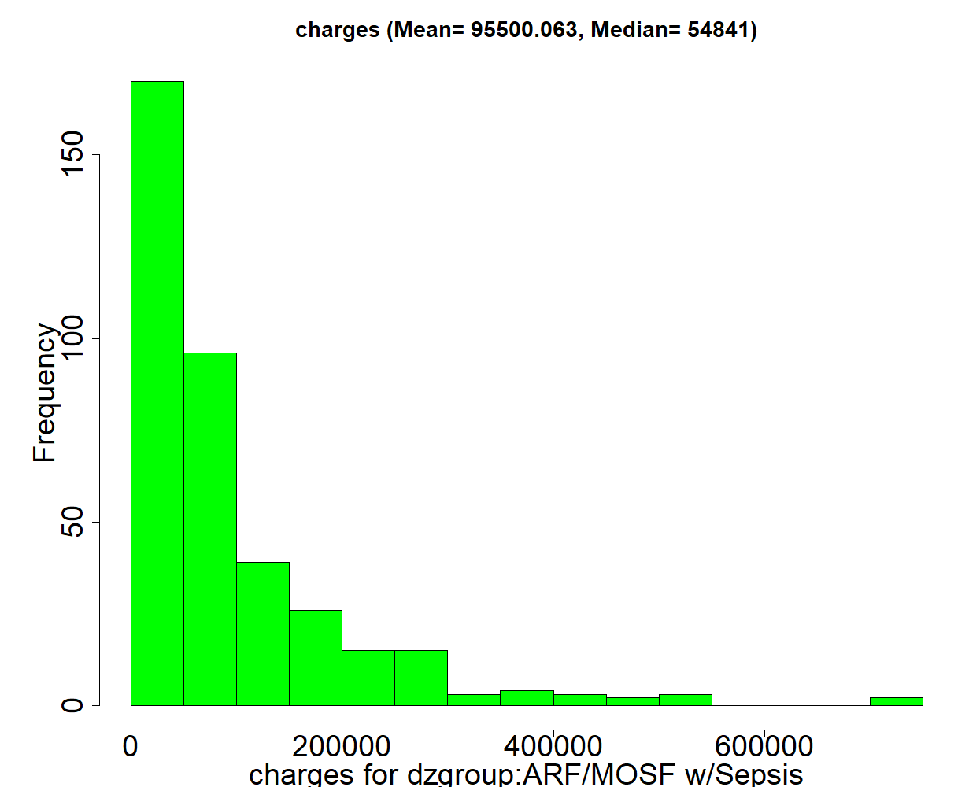
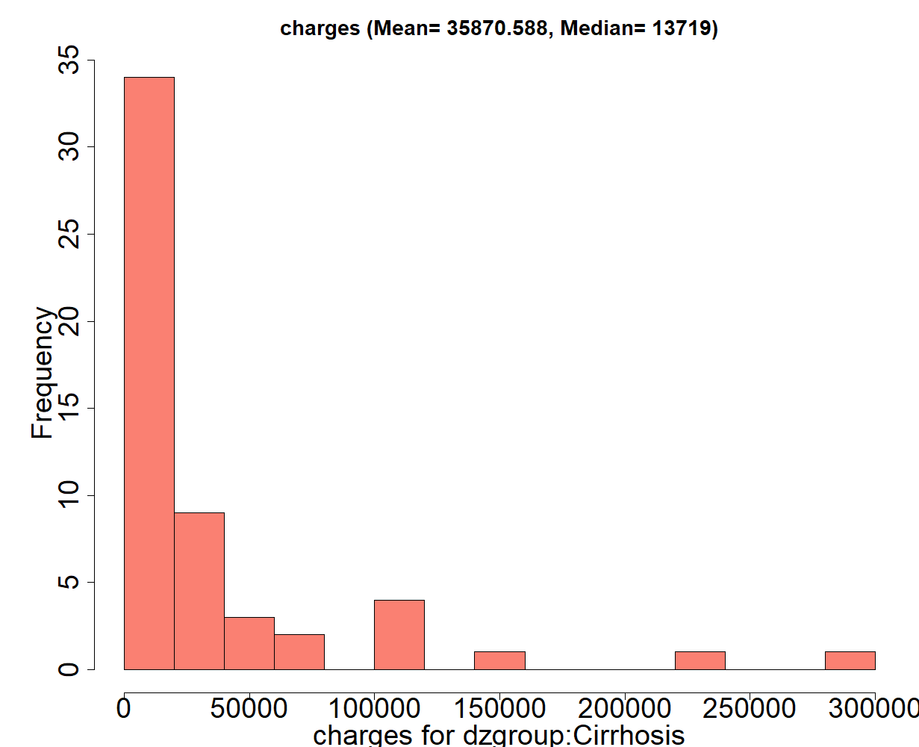
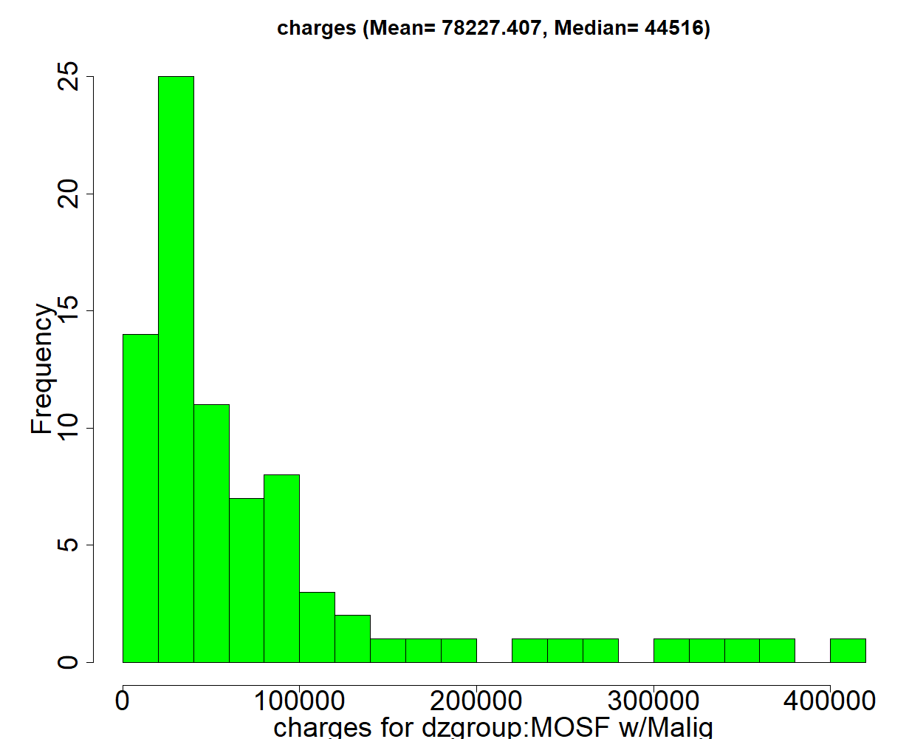
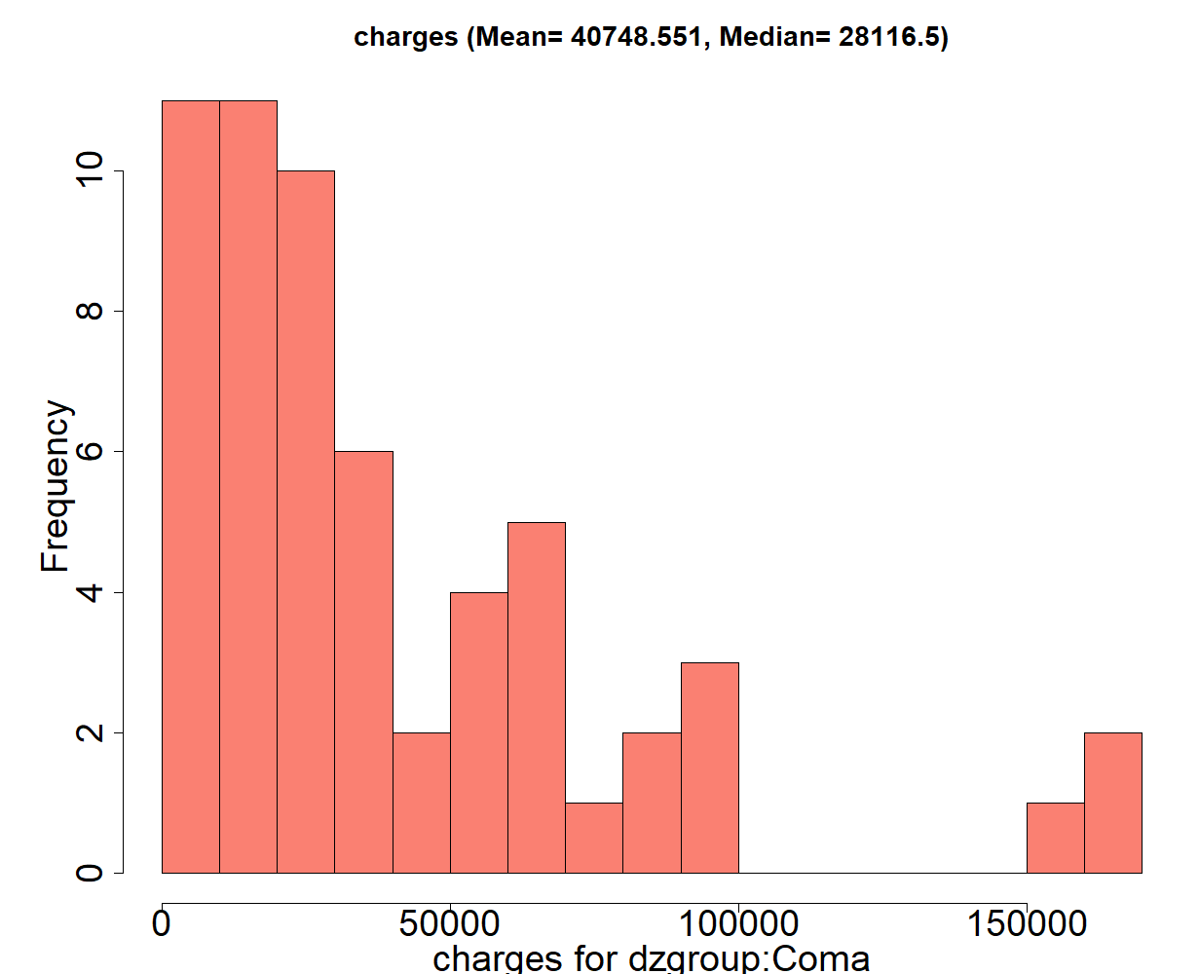
Mean = $95,500 Median = $54,841
Mean = $35,870 Median = $13,719
We’ll compare the hospital charges for 1) Acute renal failure/Multiple organ system failure with Sepsis and 2) Multiple organ system failure with malignancy
We’ll compare the hospital charges for 1) Cirrhosis and 2) Coma.
Mean = $78,227 Median = $44,516
Mean = $40,749 Median = $28,117
The mean difference between the two is $17,273
The mean difference between the two is $4,879

Slide 13
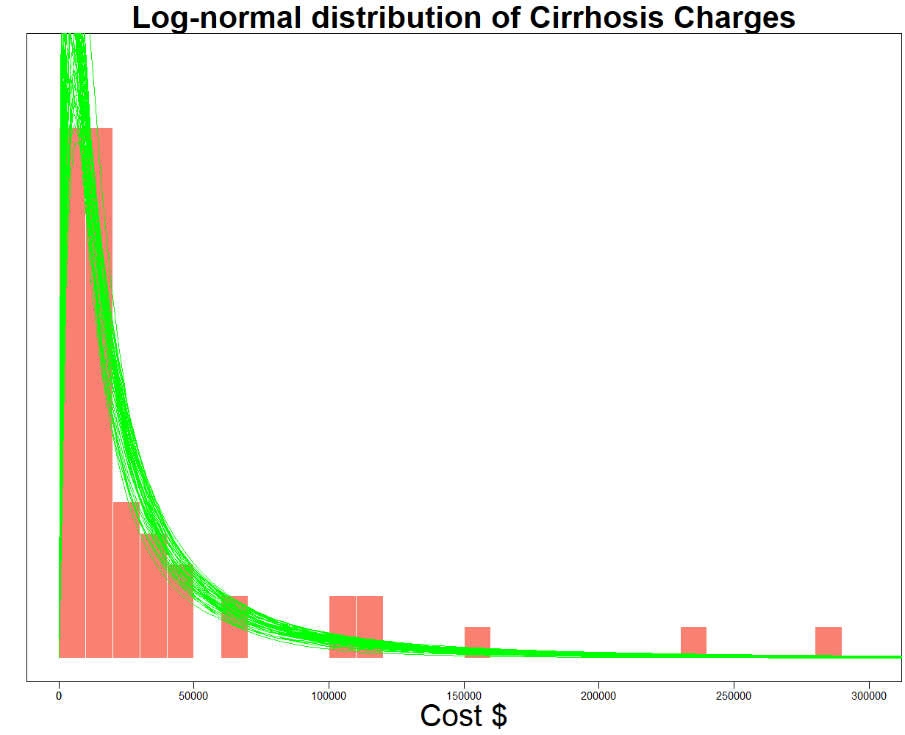
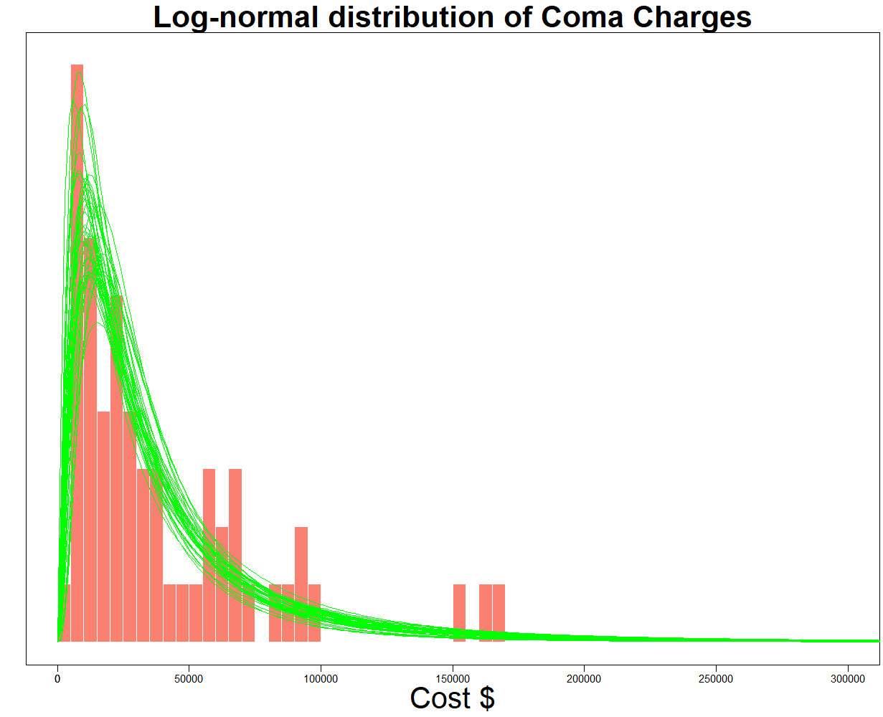
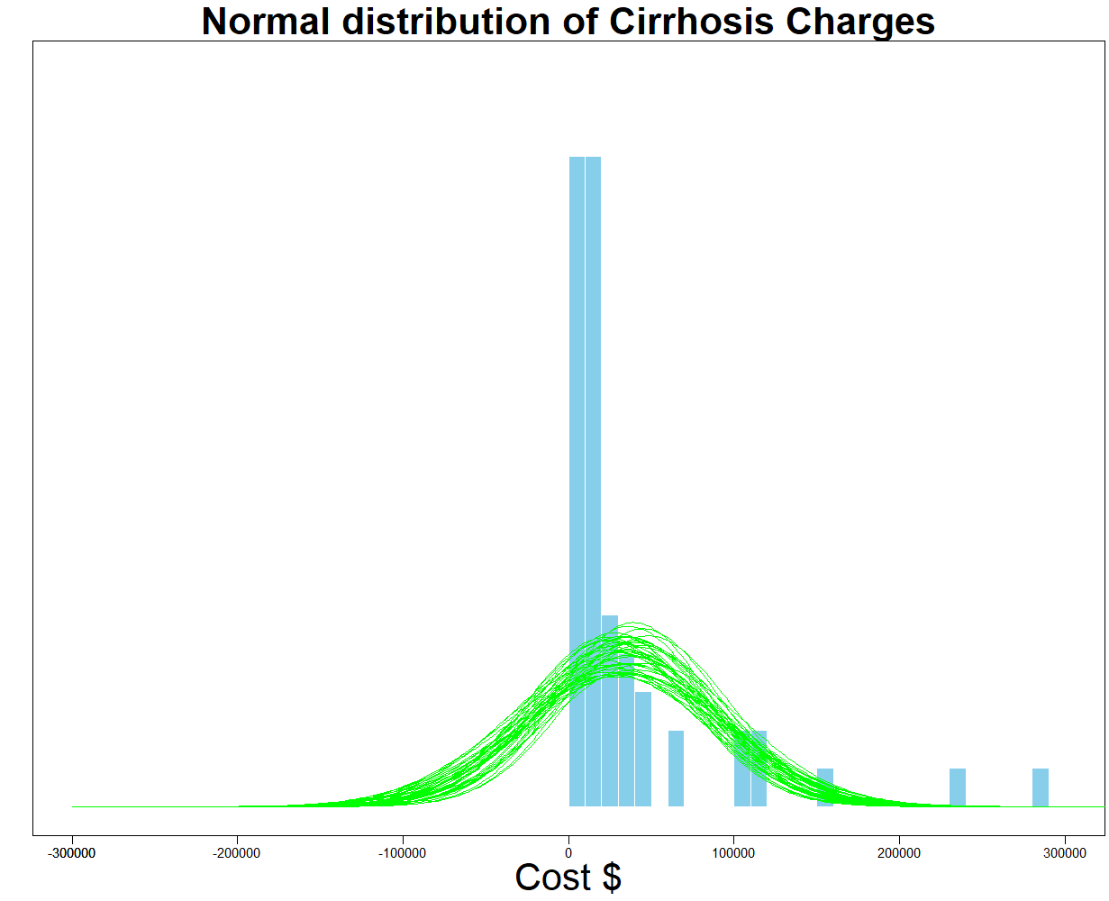
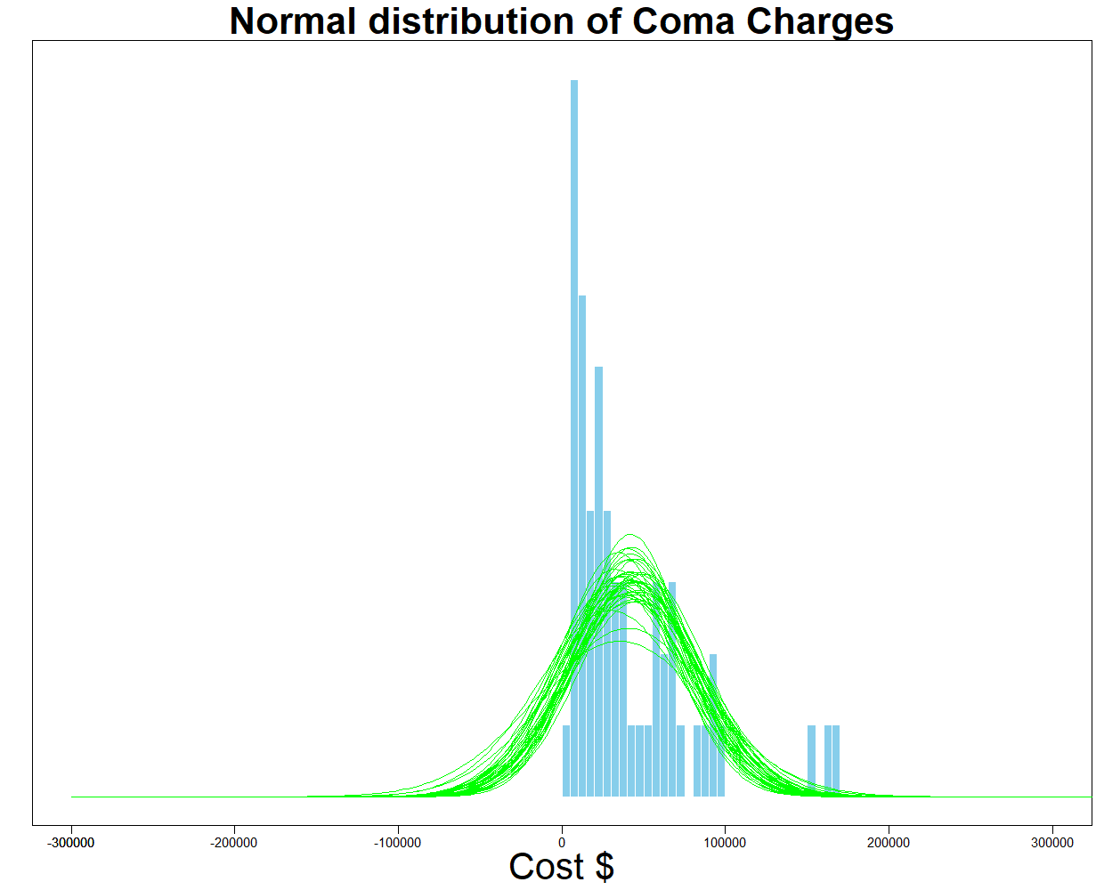
The green lines represent estimates and the bars represent actual data.
The overlap indicates the estimates fit the data well using a log-normal distribution
Significant cost differences
Mode = $6,210.
Median = $9,570.
Mean = $6,420 (not significant).
This is a textbook example of how a normal distribution has problems with skewed data.
It stretches over to impossible negative $$.
Cost difference
Mean = $5,370 (not significant).
And both over and underestimates variation

Slide 14

Results
The results from a t-test or regression would not be significant because both means are very skewed.
However, if describing the median or mode of the data is meaningful, the significant differences in medians and modes would be helpful to your audience and worth explaining in your study.
Consider median tests when appropriate. Unlike a t-test, it showed a significant difference between Cirrhosis and Coma charges (p = 0.006).
The biggest difference between similar costing disease groups (ARF/MOSF w/ Sepsis and MOSF with malignancy) was not significant even though the difference was 3 times larger than Cirrhosis and Coma.

Slide 15

Summary
Maybe the single most useful analysis is examining our descriptive statistics.
Understanding the importance of our distributions and the different types of “averages” can help with the interpretation of our results.
The example used Bayesian statistics which focuses on distributions. This method showed significant differences with the log-normal distribution for means in 2 other disease groups (not shown) in which they were previously not significant using normal distributions.

Slide 16

Post-Knowledge check
What are examples of distributions?
Positively skewed distribution
Negatively skewed distribution
Bimodal distribution
Normal distribution
All the above
In statistics, the measure of central tendency of a probability distribution along with the median and mode is called:
Mean
Median
Mode
Standard Deviation
All the above
https://forms.office.com/r/k16ww6yhQ5

Slide 17
Knowledge check-- Answers
What are examples of distributions?
Positively skewed distribution
Negatively skewed distribution
Bimodal distribution
Normal distribution
All the above
In statistics, the measure of central tendency of a probability distribution along with the median and mode is called:
Mean
Median
Mode
Standard Deviation
All the above

Slide 18
Appendix A
Skewness, Kurtosis and SPSS examples

Slide 19
Levels of measurement
Nominal: Named levels (med center name, medical record number).
Ordinal: Rank-ordered, distances between levels are not assumed equal or meaningful (1st, 2nd, 3rd places in a baking contest).
Interval: Rank-ordered and meaningful distances between levels. But has no 0 (SAT scores).
Ratio (ounces, money)
Importance in determining which statistical test to select.

Slide 20
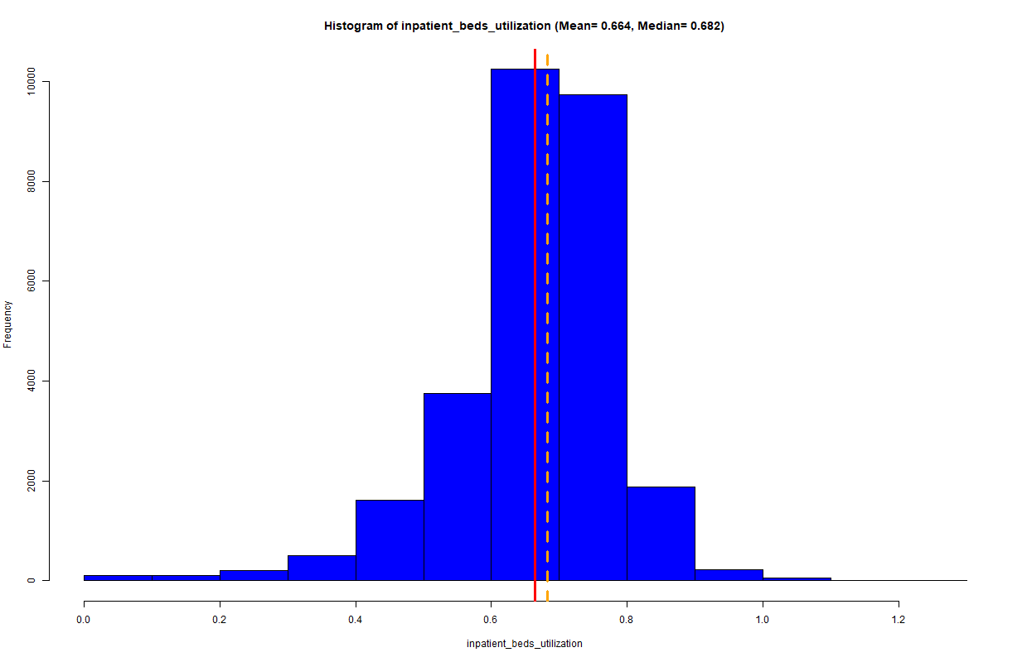
Normal distribution with a slight left tail (Mesokurtic with a slight negative skew)
We can tell it has a negative skew because the tail drifts off to the left which pulls the mean to the left of the median. But the mean and median are still relatively close.
Left tail

Slide 21
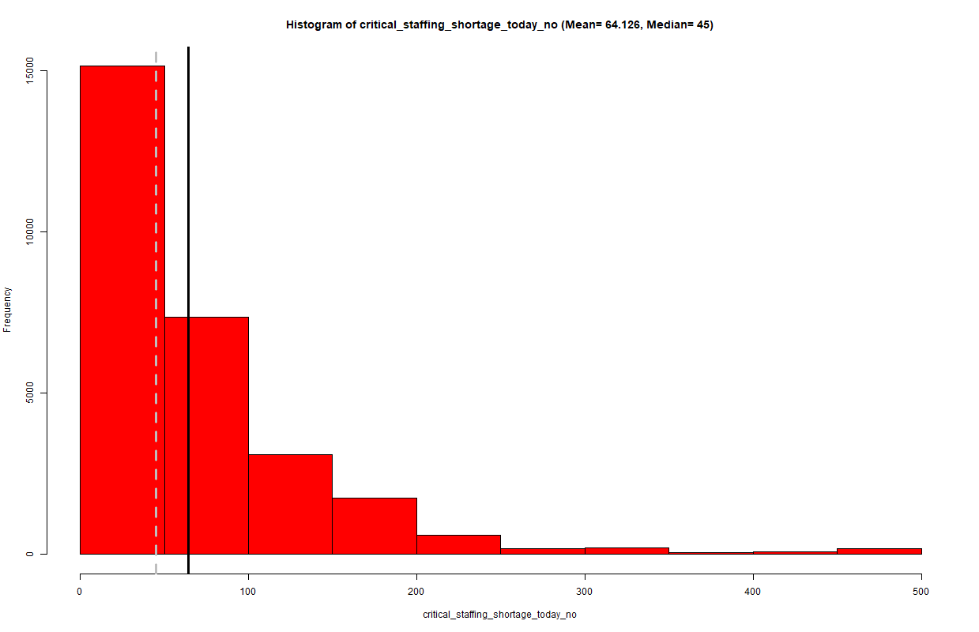
Right tail (Positive skew)
The right tail is another description of a positive skew. The tail drifts off to the right which pulls the mean towards the high values and to the right of the median
Right tail

Slide 22
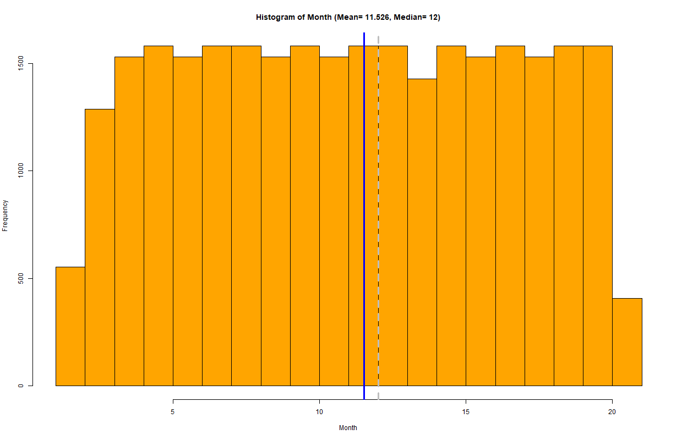
Wide spread distribution and heavier tails (Platykurtic, almost a “uniform distribution”)
With a standard deviation of 5.37 and a coefficient of variation 0.47, we may think of it as a slight “normal distribution”.
The mean is to the left of the median and suggests a minor left tail.

Slide 23
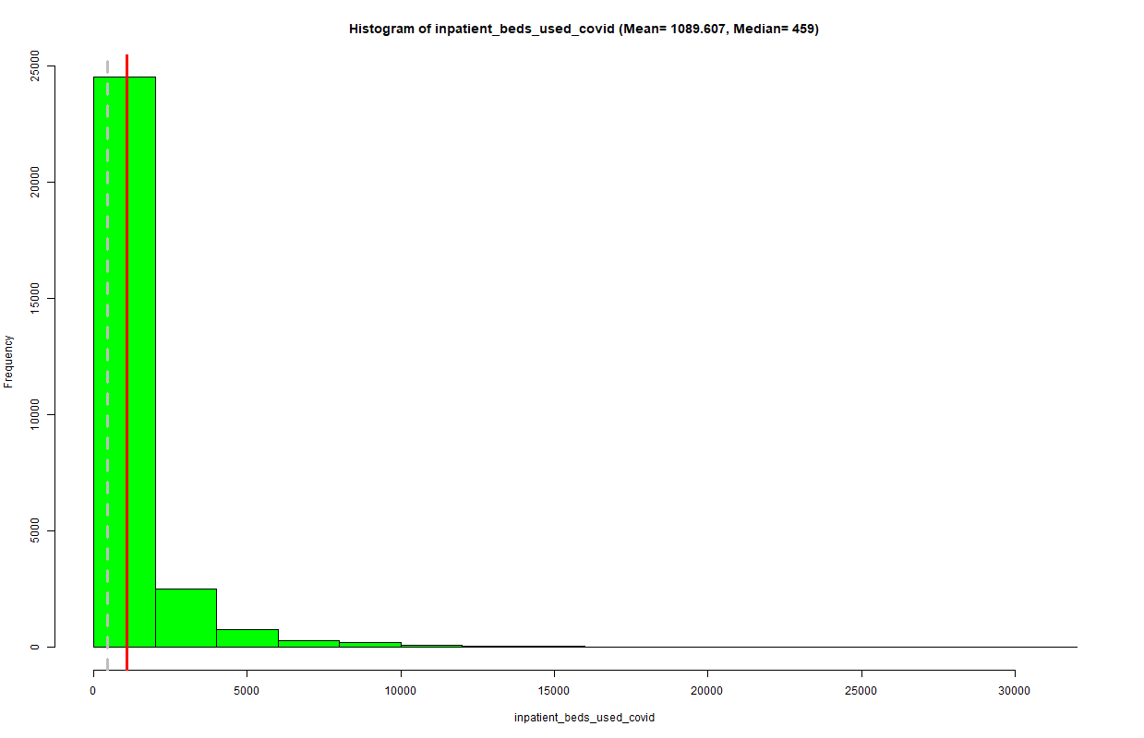
Narrow distribution with a right tail (Leptokurtic and positive skew)
Graphing is helpful for understanding a distribution. But we need to be careful not to overlook important statistical properties.
This variable has the highest COV even though it appears to have the least variation. The reason is how the standard deviation is calculated and because highly skewed data inflates the SD.
Although the distribution is skewed, you can still make use of the mean (e.g., cost projections). It is the estimation of the standard deviation and is most impacted by skewed data.

Slide 24
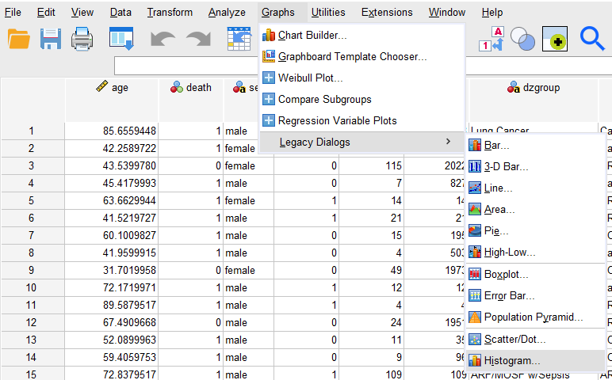
How to make histograms for hospital charges

Slide 25
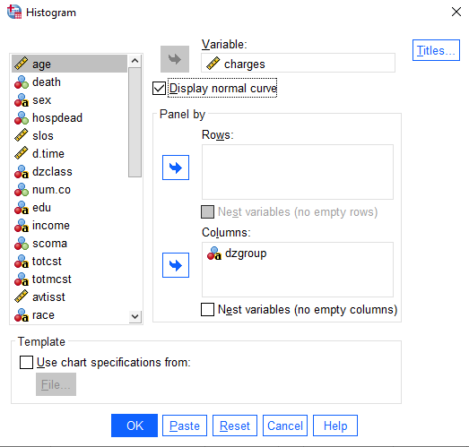
Then select the variable “charges” and “panel by” disease groups
You can display a normal curve with the histograms.
You can display the histograms by Rows or Columns

Slide 26
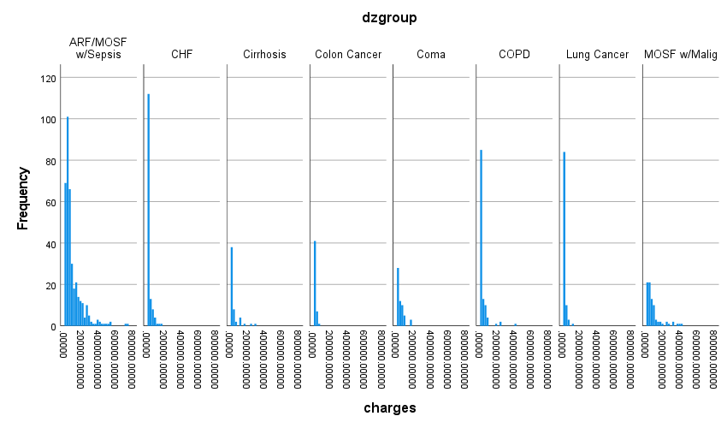
Histograms for the 8 disease groups
Doesn’t include the normal curves because there are too many histograms and most are small.

Slide 27
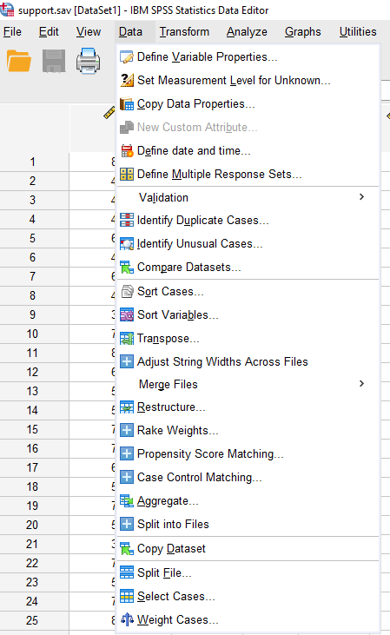
How to get descriptive statistics by disease group
Splitting the file will allow you to get descriptive statistics for each group in a factor like disease group (“dzgroup”).

Slide 28
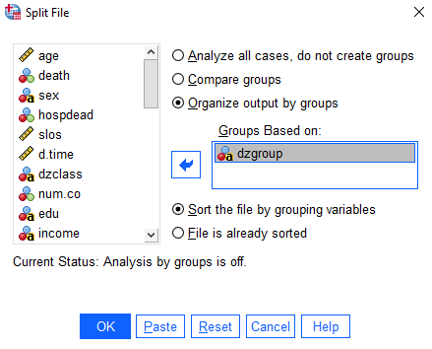
Select the factor to compare output by disease groups

Slide 29
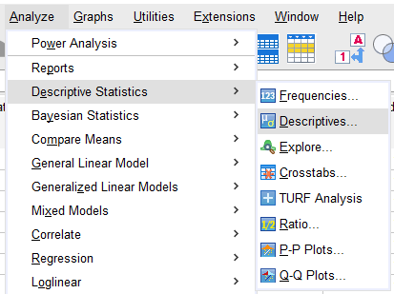
Get Descriptive Statistics

Slide 30
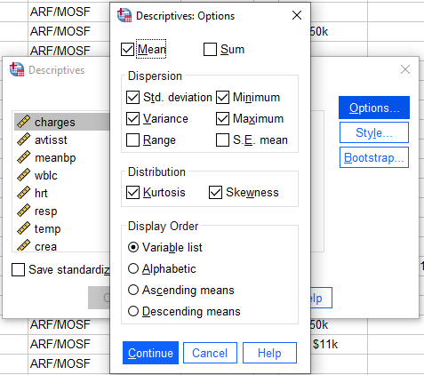
Select additional statistics in “Options” (e.g., skewness and kurtosis of the distribution)

Slide 31
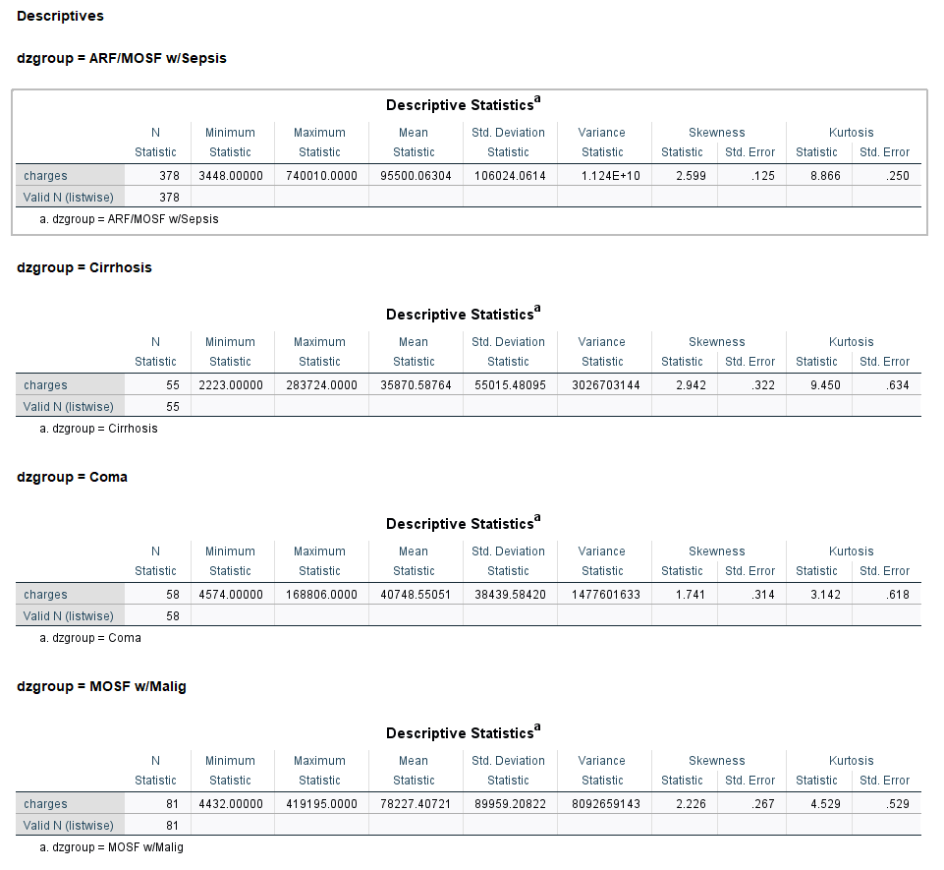
The output will have the standard set of descriptives with measures on skewness and kurtosis

