Slide 1
Research and Statistics
Session 1: Research design, qualitative and quantitative methods

Slide 2
Syllabus: Research and Statistics
Purpose: An introduction to each topic will help answer two questions, “What is it?” and “Why do we use it?”. The focus of the sessions will be on understanding the key concepts of statistics.
Presentations
1. Research and statistics: Research design, qualitative and quantitative methods
2. Distributions: Central tendency and variability
3. Relationships in the data: Correlations and scatterplots
4. Inference: Confidence intervals and statistical significance
5. Inference: Hypothesis testing using distribution tests (t-test, chi-square, ANOVA)
6. Inference: Power analysis (t-test, chi-square)
7. Measurement and Assessment: Scales, factor analysis, and cluster analysis
8. Linear regression: Hypothesis testing, estimating effect sizes, and predictions for continuous outcomes (and ANCOVA).
9. Logistic regression: Hypothesis testing, estimating effect sizes, and predictions for dichotomous outcomes.
Optional readings: All readings are optional. The primary texts I will reference are “How to Think About Statistics, 5th Edition” and “Fundamentals of Biostatistics, 7th Edition”. “Experimental and Quasi-Experimental Designs” is an excellent book on research design. The 1950 study by Doll & Hill identified the association between smoking and lung cancer. And the remaining books can serve as references on statistics for your future work.
Notes: All presentation notes will be provided in power point files.
Data: Data are in SPSS format or as CSV files that can be opened with Excel or other statistical software.
Files: All power points, readings, and data are found with the link below.
Nursing Research - SCAL-Quality Systems and Reporting - AKME Confluence (kp.org)
YouTube links to my previous courses that cover some of the topics in greater detail are found here:
Statistics - SCAL-Quality Systems and Reporting - AKME Confluence (kp.org)

Slide 3
Research Methods
In this session, we’ll cover research design and statistics.
More formally, we describe statistics in terms of “research methods”.

Slide 4
Research Methods
We generally have 2 types of research methods.
Qualitative: Data reduction (themes based on reviewing text, interviews or surveys). We do have survey research methods that are quantitative. But in the qualitative sense, we form themes based on trends in survey responses.
Quantitative: Statistics.

Slide 5
Research Methods
Research and Evaluation, this is traditionally where the two methods are applied differently.
Quantitative methods are primarily used in research while qualitative methods are used in evaluation.
The main difference between research and evaluation is “generalizability”.

Slide 6
Generalizability
Generalizability is making an inference from your sample data to the larger population.
Generalizability is usually not a concern in evaluation which focuses on site-specific characteristics, therefore not requiring inferential statistics (e.g., if you had a high missed appointment rate in your department, the solution might be to offer rides rather than use a statewide program).

Slide 7
Research and Evaluation
In research, we may use simple descriptive statistics and more advanced statistics that are meant to make inferences to the larger population with the goal of generalizability. While in evaluation, we may use our descriptive data analysis to understand site specific “cause and effect”.
Often, Research and Evaluation look almost identical, especially for multi-site evaluations.
And of course, we can use both qualitative and quantitative methods in research and evaluation and we would describe those as “mixed-methods”.

Slide 8
Use of Statistics in Research
We often discuss research and statistics as being part of the same process. But they began as two separate fields.
However, there is a natural fit with research and statistics. For example, we can use a t-test to assess the hypothesis that the LOS for Time 1 and Time 2 are equal.

Slide 9
Hypothesis Testing
We’ll later discuss using distribution tests for hypothesis testing.
For example, H0: A = B (or A – B = 0) and H1: A ≠ B (or A - B ≠ 0). E.g., Time 1 average = Time 2 average.
Our null hypothesis is that there is no difference between the control and treatment groups (or time periods) and the results would indicate if we can reject the null hypothesis or fail to reject the null hypothesis.
Note that in Frequentist statistics, we can’t accept the null hypothesis that a difference is 0 but Bayesian statistics allows us to accept the null hypothesis.

Slide 10

Research questions
Our hypotheses are based on our research questions which are informed by the theory we read during our literature review.

Slide 11

Research Design
We formalize how we’ll answer our research questions and hypotheses.
We try to reduce internal (how we did the study) and external (generalizations from the study) threats to validity. For example, we may use multiple time periods and/or multiple groups.

Slide 12
Research Methods
These are the analytical methods we’ll use to accurately answer our research questions. Here, statistics.

Slide 13
Most common design
We often use the “quasi-experimental” research design, it isn’t the “true experiment” approach (e.g., research done in a lab).
In health care, it can be impractical or unethical to use randomization of subjects into control or treatment groups. We instead rely on our research design to give us the most accurate results.

Slide 14
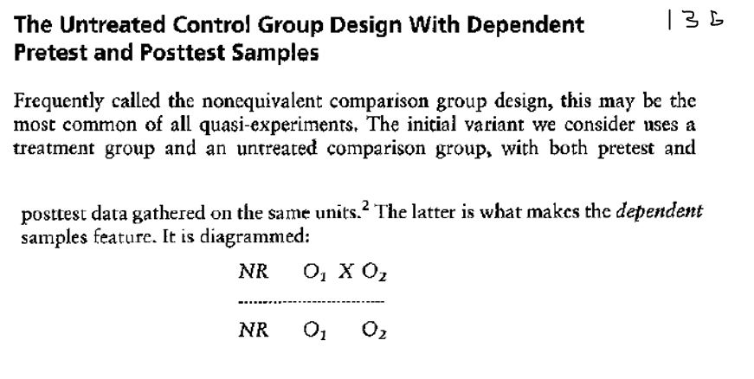
Pre-test/Post-test with a control group
Treatment
Treatment and Control groups
We can also use designs that don’t have identical subjects in both the pre- and post-tests. See Appendix.
NR = Non-randomization
Pre- and Post tests

Slide 15

Summary
In summary, research articles generally follow this format: 1) Introduction, 2) Literature Review, 3) Research Methods, 4) Results, and 5) Conclusions.
Statistics is a part of each section.
For example, the methods we select based on the research questions of the first sections and the analyses found in the later sections.

Slide 16
Knowledge check
What are the two types of research methods? Select all that apply.
Quantitative and Qualitative
Quantitative and Qualtrics
Qualitative and Quantity
Quasi-experimental and Placebo groups
2) What is the main difference between research and evaluation?
Statistical analysis plan
Theoretical framework used
Generalizability
Sample size
3) True or False:
A null hypothesis would state that there is no difference between control and treatment groups (or time periods), thus the results of a study would either indicate to reject the null hypothesis or fail to reject the null hypothesis.
4) The statistics plan of a general research article format would be in this section:
Introduction
Literature review
Methods
Results
Conclusions

Slide 17
Knowledge check-- Answers
What are the two types of research methods? Select all that apply.
Quantitative and Qualitative
Quantitative and Qualtrics
Qualitative and Quantity
Quasi-experimental and Placebo groups
2) What is the main difference between research and evaluation?
Statistical analysis plan
Theoretical framework used
Generalizability
Sample size
3) True or False:
A null hypothesis would state that there is no difference between control and treatment groups (or time periods), thus the results of a study would either indicate to reject the null hypothesis or fail to reject the null hypothesis.
4) The statistics plan of a general research article format would be in this section:
Introduction
Literature review
Methods
Results
Conclusions

Slide 18
Appendix
Examples from “Experimental and Quasi-Experimental Designs for Generalized Causal Inference, 2nd Edition”. Shadish, Campbell, & Cook (2001)

Slide 19
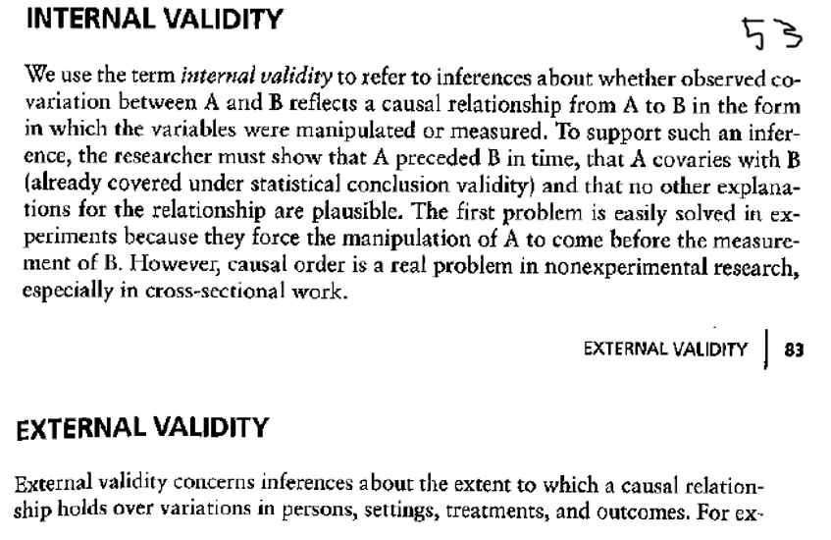
Validity

Slide 20
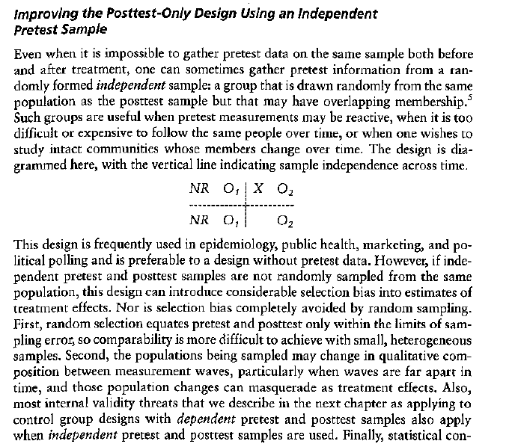
We don’t need to have identical subjects in both the pre- and post-tests. This is common in healthcare.

